Slide 1
FINAL ORAL EXAM PRACTICE

Slide 2
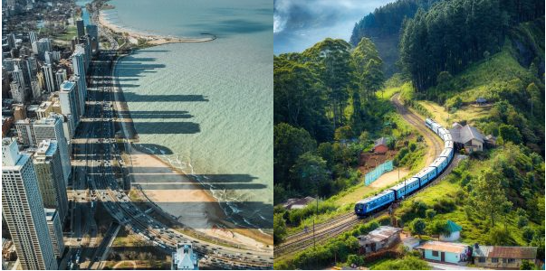
PICTURE DESCRIPTION
These photographs show various places where people live. I’d like you to compare the photographs (the landscapes, the structures), and say why people might choose to live there.

Slide 3
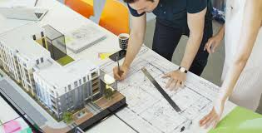
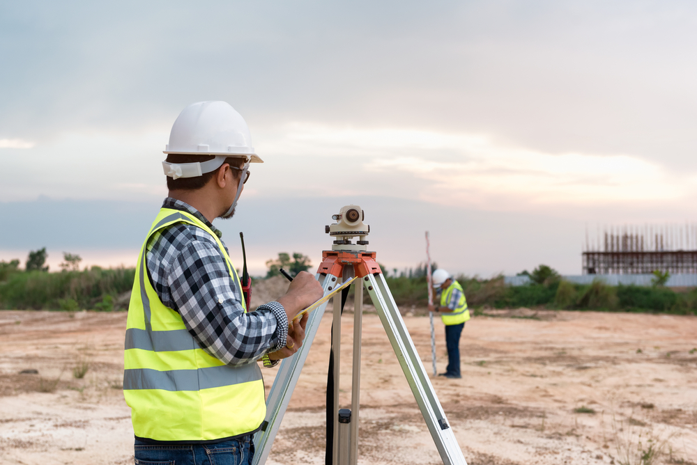
PICTURE DESCRIPTION
These photographs are about different jobs. I’d like you to describe them and talk about frequent qualities of people in these fields. Also, include information about the education of each of them.

Slide 4
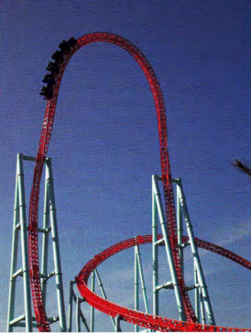
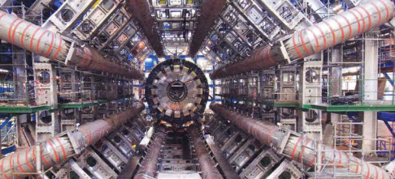
PICTURE DESCRIPTION
These photographs are about different structures. I’d like you to describe them and to say where you would prefer to work, what your job would consist of and why you would do it.

Slide 5
SITUATION
DIALOGUE: BUILDING A SHOPPING CENTRE IN MENDOZA
STUDENT A: YOU AND YOUR PARTNERS ARE ABOUT TO BUILD A NEW SHOPPING CENTRE IN MENDOZA. TELEPHONE AN ARCHITECT AND TELL HIM ABOUT YOUR IDEAS. ASK FOR A BUDGET.
STUDENT B: MAKE QUESTIONS ABOUT THE PLACE AND DESIRES FOR THE NEW SHOPPING CENTRE. FIND A PROBLEM IN THE DESIGN PROPOSED AND MAKE SUGGESTIONS ABOUT DIFFERENT WAYS TO SOLVE THE PROBLEM. MAKE 1 OR 2 CALCULATIONS.

