Slide 1
Parts of a building – a house

Slide 2
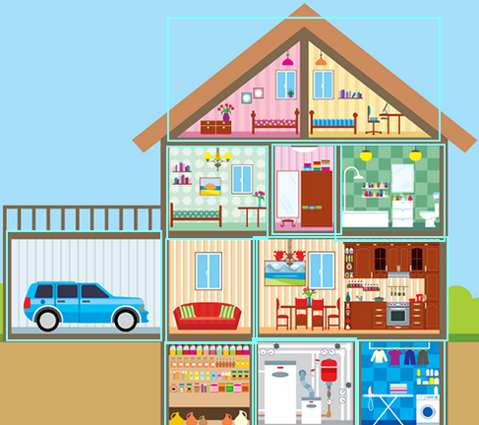

Slide 3
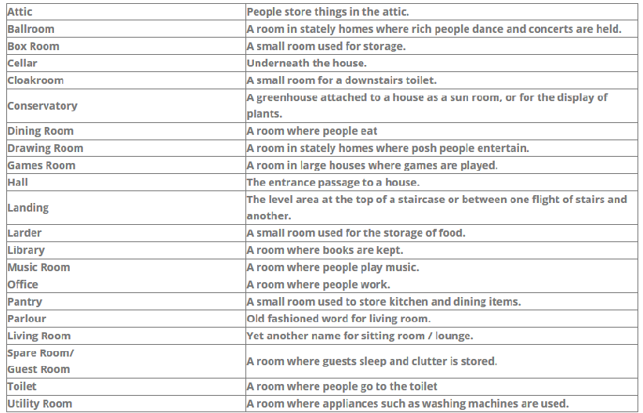
OTHER ROOMS

Slide 4
