Slide 1
TRABAJO PRÁCTICO 10
Comparación de adjetivos y adverbios: comunes, irregulares, comparativos especiales.

Slide 2
A. Traduzca las siguientes oraciones

Slide 3
1. These processes require less equipment than those used on global export facilities and are far less complex, which lead to a simplified operation.
2. Durability issues can drive up costs—the higher the FRC replacement rate, the higher the overall costs. (FRC: flame-resistant clothing)

Slide 4
3. "Standard culture conditions are like a five-star hotel for Geobacter," says Gemma Reguera of Michigan State University in East Lansing, who led the research. "We had to make life a little rougher for them."
4. The micro-hardness has increased from the outer side of tube towards the inner side of the tube in HAZ area of the failed pipe.

Slide 5
Geobacterias: son bacterias anaeróbicas que tienen capacidades que las hacen útiles para biorremediación. Fueron los primeros organismos que se encontraron con la capacidad de oxidar compuestos orgánicos, metales y derivados del petróleo y transformarlos en compuestos benignos para el medioambiente. En este caso es el nombre de una bacteria usada para eliminar uranio que contamina las aguas.
Microdureza: es la resistencia que opone la superficie lisa de un material a ser perforado o rayado.
HAZ: heat affected zone: En la soldadura, la zona afectada por el calor es el área del material base, sea un metal o termoplástico, no se derrite pero altera su microestructura y propiedades.

Slide 6
5. Of course, we also need an environment that connects people, is well-lit – the more daylight the better – well-ventilated, has good temperature controls, is connected to nature and where water is readily available to keep us hydrated.
6. Eight of my favorite green building experts were asked one question: “What notable trends ensure us to live a better and better life?”

Slide 7
7. The underlying framework needs to be as efficient as it can be, either managing the data, enabling the geophysical process, or both.
8. "This work ties a lot of things together," says Derek Lovley, a microbiologist at the University of Massachusetts Amherst and Reguera's former postdoctoral supervisor.

Slide 8
9. The materials intensity of products and processes is a good proxy for their environmental impacts, i.e. the more material is needed in a given product or service, the larger the environmental impact caused in the production stage of those materials.
10. Nonetheless, looking at the timeline of events in the management of Ghana’s e-waste, a significant activity and intervention is the establishment of a legal framework

Slide 9
11. In brief, these wearable suits help people to walk and lift heavy objects with minimal effort, reducing required muscle force by as much as 60%.
12. Materials that increase the life of existing building supplies such as self-healing concrete will also become a lot more popular.

Slide 10
Wearable suit: traje portable, se trata de un traje artificial.
By: hay un significado de by asociado con cantidades y porcentajes. Al estar as much as, la preposición by no se traduce, si la frase fuera reducing required muscle force by 60%. Ahí sí se traduciría by y quedaría reduciendo la fuerza muscular requerida en un 60%.

Slide 11
13. Nanomaterials are usually defined as materials that have at least one dimension smaller than 100 nanometers.
14. In stabilized grades, Sigma phase precipitation is faster than other grades of stainless steel grades (for example as is shown in Fig. 2, precipitating in alloy 347 is slightly faster than that in alloy 321)

Slide 12
C. 1) En el siguiente texto, subraye todos los casos de estructuras comparativas y superlativas (comunes y especiales), y 2) Traduzca dichas oraciones.

Slide 13
6 of the lightest and strongest materials on Earth

Slide 14
The future of construction is getting more and more exciting thanks to huge technological developments in material innovation. Researchers are constantly developing new materials that are stronger and lighter than ever before, paving the way¹ to a more energy-efficient and eco-friendly² future in everything from transportation to medical technology. We’ve rounded up six cutting-edge materials that rank³ among some of the lightest and strongest ever discovered—keep reading to see them all.

Slide 15
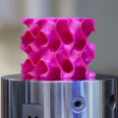
3D Graphene

Slide 16
Made from pure carbon, ultra-thin graphene is thought to be one of the strongest materials on the planet. But earlier this year, researchers at MIT found a way to turn two-dimensional graphene into a three-dimensional structure by designing a new material with a sponge-like configuration that’s 5 percent the density of steel and about 10 times as strong. The super-strong and lightweight 3D graphene has been shown⁴ to be stronger than its 2D counterpart and offers greater⁵ potential uses thanks to its building block form.

Slide 17
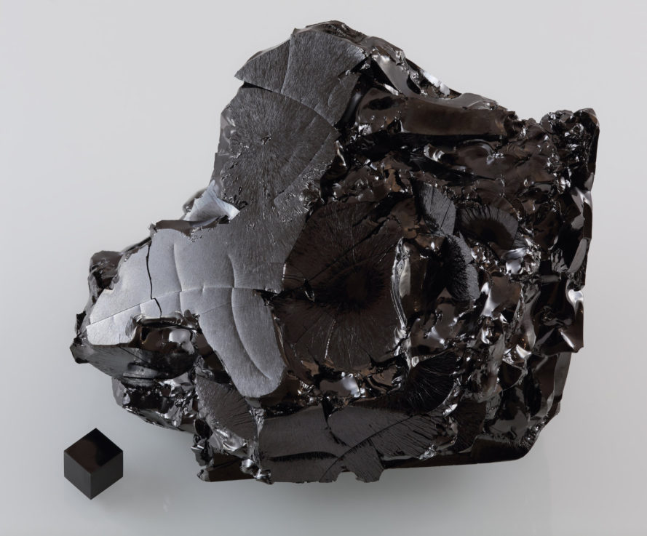
Carbyne

Slide 18
In the spring of 2016, a team of Austrian researchers revealed that they were able to successfully synthesize Carbyne, an exotic form of carbon that they say⁶ is the strongest of all known materials—even⁷ surpassing graphene. Considered the holy grail of carbon allotropes, Carbyne is made from a monodimensional chain of carbon atoms that’s highly reactive, making it very tricky to synthesize. The stiff material is believed to be twice as strong as carbon nanotubes.

Slide 19
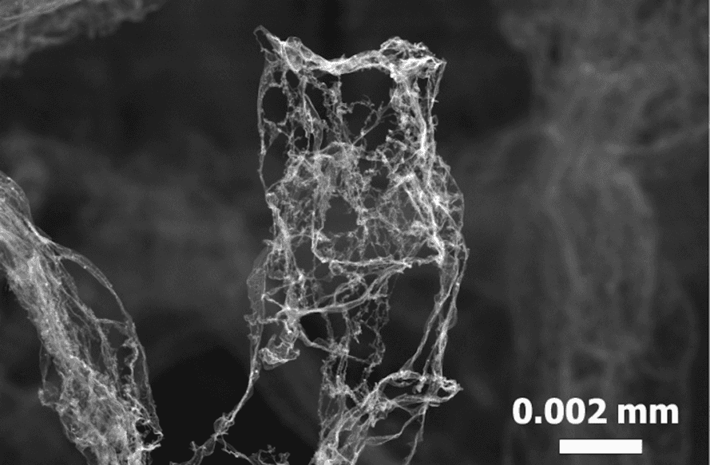
Aerographite

Slide 20
Created from a network of porous carbon tubes, aerographite is synthetic foam that’s one of the lightest structural materials ever⁸ created. Developed by researchers at the University of Kiel and the Technical University of Hamburg, aerographite can be produced in a variety of shapes and boasts a density of just 180 grams per cubic meter, making it about 75 times lighter than styrofoam⁹. The material could be used on the electrodes of lithium ion batteries to reduce their weight.

Slide 21
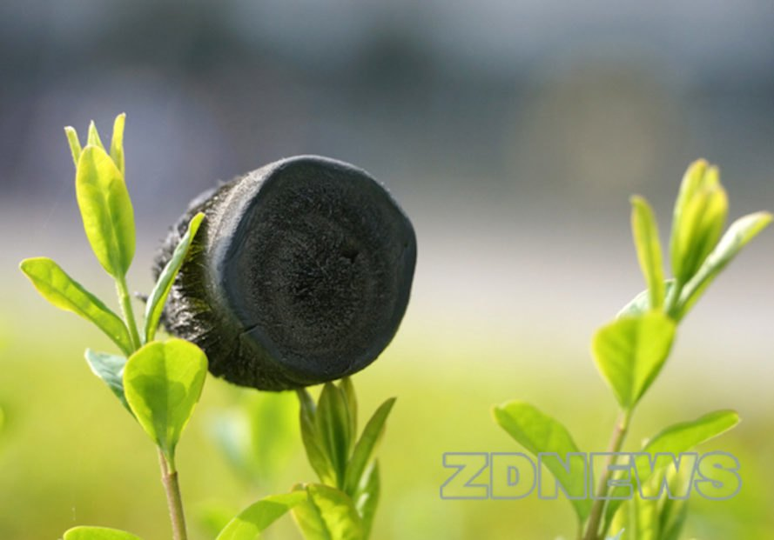
Aerographene

Slide 22
Aerographene, also known as graphene aerogel, is believed to be the world’s lightest material with a density of just 0.16 milligram per cubic centimeter. Zhejiang University researchers developed the material, which is approximately 7.5 times less dense than air. The extremely elastic material can absorb up to 900 times their own weight in oil and water, making oil spill cleanups a potential application.

Slide 23
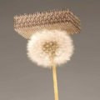
Metallic microlattice

Slide 24
Metallic microlattice¹⁰ is the world’s lightest metal and one of the lightest structural materials. This synthetic porous material made from nickel phosphorous¹¹ tubes has a density as low as 0.9 milligrams per cubic centimeter. Potential uses include applications in automotive engineering, aeronautical engineering, and more.

Slide 25
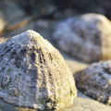
Limpet teeth

Slide 26
The teeth of limpets¹², the term for aquatic snails found clinging to rocky shores, are considered to be one of the strongest biological materials in the world. Made of a mineral-protein composite, limpet teeth have been revealed in a University of Portsmouth study to be much stronger than spider silk. Its strength is believed to be due to its tightly packed¹³ mineral fibers, which scientists could combine into man-made¹⁴ composites to create stronger planes, cars, and even dental fillings.

Slide 27
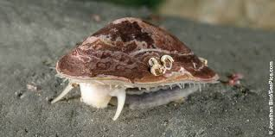

Slide 28
Introducción
¹Pave the way: pave es pavimentar, pero esto es una frase que se traduce como preparar, allanar el camino.
²Eco friendly: se traduce como ecológico, amigable con el medio ambiente sería también aceptable, pero ecológico sintetiza mejor la misma idea.
³Rank: buscar un significado que se adapte a la frase, ya que no tiene aquí ninguno de los significados comunes.
Grafeno 3D
⁴Shown: traduzcan como demostrar.
⁵Greater: en este contexto se traduce como más importante

Slide 29
Carbino
⁶They say: Esta frase es impersonal por lo que se traduce como se dice.
⁷Even: Recuerden que en el texto está como adverbio y está en afirmativo.
Aerografito
⁸Ever created: ever aquí es, como en la mayoría de los casos alguna vez.
⁹Styrofoam: espuma de poliestireno.

Slide 30
Metallic Microlattice
¹⁰Metallic microlattice: microrretícula metálica.
¹¹Nickel phosphorous: phosphorous es fosforoso, pero la microrretícula metálica está compuesta por tubos de una aleación de níquel y fósforo, por lo tanto hay que traducirlo como aleación de níquel y fósforo, aunque no esté presente la palabra aleación.
Limpet teeth
¹²Limpet teeth: dientes de lapa
¹³Tightly packed: ya que está referido a las fibras no se sugiere traducir packed como empacadas, sería mejor usar dispuestas apretadamente.
¹⁴Man made: se traduce como sintético, ya que lo hecho por el hombre se opone a lo natural.

