Slide 1
TRABAJO PRÁCTICO 6
Traducciones con se: pasivas, pasivas especiales, con elipsis, con sujeto consciente, verbos intransitivos, usos impersonales de you y one.

Slide 2
I. TRADUCCIONES CON “SE”

Slide 3
A. Traduzca la oraciones con casos de traducción con “se”.

Slide 4
1. Efforts have been made to define these windows and to expand them while still retaining regulatory permission.
2. Rolling bearing is one of the key components in rotating machinery and it is widely employed in wind turbines.

Slide 5
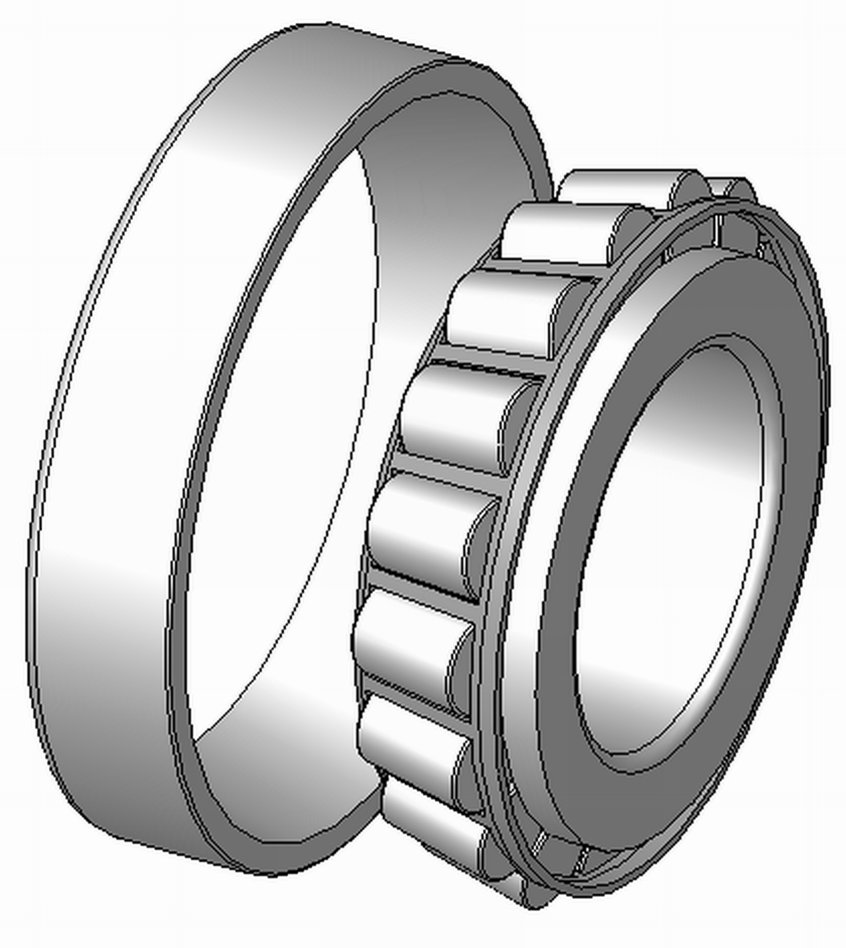

Slide 6
3. FeO is one of metastable corrosion product forms which can oxidize continuously to form stable corrosion products.
4. You should be constantly aware of hazards in your workplace.
5. Meanwhile, compared with these statistical indicators, the advantages of sample entropy in early fault detection is revealed.

Slide 7
6. He had been assigned to haul a load of crude oil.
7. The formation of chromium rich phases together with thermal fatigue stresses were found to be main causes of failure.

Slide 8
II. ELIPSIS

Slide 9
A. Traduzca los siguientes casos de elipsis

Slide 10
1. If necessary, pressure surges can be minimized by installing surge tanks and using valves that open and close slowly.
2. As expected, the development of this new market will come hand in hand with challenges that will need to be overcome.

Slide 11
3. Therefore, these reduced emissions and waste are considered when evaluating the costs of the alternative inspection techniques.
4. Where appropriate, the results are compared with those obtained for bentonite fluids by other investigators.

Slide 12
C. Traduzca el siguiente texto.

Slide 13
Awareness of corrosion importance among engineering undergraduates in the United Arab Emirates
Article (PDF Available) in Educational Research 9(2):021-034 · March 2018
Hwee Lim - Khalifa University E. Gunister - Khalifa University
Abstract

Slide 14
Engineers are ethically responsible for managing corrosion. While applying corrosion control methods in the industry, it is as important to educate engineering undergraduates on aspects of corrosion and its management. However, there is little research on corrosion awareness among undergraduate students. This qualitative study examined engineering undergraduates’ awareness of corrosion importance in the petroleum industry.

Slide 15
20 sophomore and 44 senior undergraduates were interviewed on their preferred level of corrosion instruction; understanding of corrosion importance in engineering work; and perceptions of own knowledge and ability to apply corrosion concepts in design. They were asked to answer a quiz on corrosion concepts. Most participants were found to prefer to study corrosion as an elective at junior and senior levels. Compared to sophomores, more seniors reported awareness of corrosion importance in engineering work and had higher positive self-perceptions of their knowledge of corrosion and application ability that were consistent with their higher quiz scores.

Slide 16
Interestingly, sophomore and senior participants were more confident of their ability to apply corrosion concepts in design than having theoretical knowledge in corrosion. The findings indicated that undergraduates need to develop greater awareness of corrosion importance in engineering work. The recommendations provided could be used to improve corrosion engineering education pedagogy.

