Slide 4
LA FRASE VERBAL: Núcleo: un verbo conjugado (puede contener una o más palabras)

Slide 5
EL VERBO BE COMO NÚCLEO
Ser o estar
Seguido de un adjetivo, o un sustantivo, es SER, seguido de una indicación de lugar es ESTAR.

Slide 6
Presente simple de BE
Am soy-estoy Are eres, son, somos, estás están estamos Is es, está. I´m an engineer. This book is about knowledge. It`s for programmers. These aren´t my tools. Are the main devices here?
Están los principales dispositivos aquí?

Slide 7
Pasado simple de BE
Was era , estaba Were eras, estabas, éramos, estábamos, eran, estaban 6. He was in the laboratory in the morning. 7. Was it in motion? 8. They were empty. 9. The prices were very convenient.
Estuvo/estaba en el laboratorio en la mañana.

Slide 8
BE: tener
The bridge is two miles long.
The mine was two hundred years old.
They were cold and hungry.
They are afraid of the results.
El Puente tiene dos millas.
tenía 200 años
Tenían frio y hambre
Tienen miedo de los resultados.

Slide 9
BE: costar, valer, llegar, hacer
The project was a million dollars.
It is cold.
We are late.
The students were early for the lecture.
It is five pounds.

Slide 10
FUTURO
ir a / tener que
Be + to infinitive indica:
un plan para el futuro que se traduce como ir a hacer algo, o haber de hacer algo.
The president is to visit this area.
They are to build new schools.
We are to heat our homes with solar units.
una obligación futura, orden o instrucción, que se traduce como tener que hacer algo, o deber hacer algo
Everybody is to leave this room now.
Employees are to follow the instructions carefully.
…
una indicación futura en el pasado: Ir a /tener que
He was to oil the shafts.
plan
obligación
Todos deben abandonar esta habitación ahora
Iba a aceitar los ejes /tenia que…

Slide 11
(Be + about + to infinitive) Es futuro con idea de proximidad a la acción
Estar por / estar a punto de
It is about to boil.
They were about to modify the plans for the house.
23. Was he about to change the diagram?
Está por hervir/ está a punto de hervir
Estaban por modificar los planos de la casa./ Estaban a punto de modificar los planos…
Estaba por cambiar el diagrama?

Slide 12
Futuro simple verbo be
The components will be here tomorrow.
The components will not be identical.
The direction and philosophy of this book will be the same.
They won´t be different.
The agent won´t be infrared radiation.
Will the values be on the computer?

Slide 13
Condicional simple verbo BE
30. The use of these devices would be beneficial for our project.
31. The missing elements would be replaced.
32. Apparently, they wouldn’t be here.

Slide 14
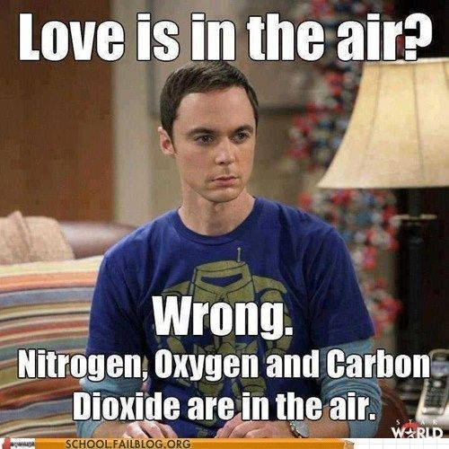
BE: SER O ESTAR?

