Slide 1
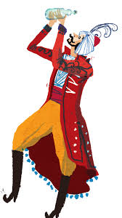
6A
A NORTH AFRICAN STORY

Slide 2
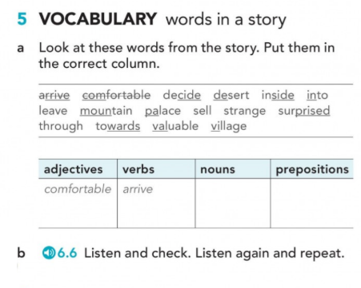
A NORTH AFRICAN STORY
47

Slide 3
Put the words in the correct place and learn about the story you are about to listen to
Work – Two – Live - Is – Desert –Family - Story
"The Glass Bottle" ____ a North African story about ___ poor brothers, Hassan and Walid, who ____ with their mother in the ___. The story is about Hassan's journey to find ___. and support his ___.

Slide 4
Put the words in the correct place and learn about the story you are about to listen to
Work – Two – Live - Is – Desert –Family - Story
"The Glass Bottle" is a North African story about two poor brothers, Hassan and Walid, who live with their mother in the desert. The story is about Hassan's journey to find work and support his family

Slide 5
A NORTH AFRICAN STORY
46/47
Listen to the story carefully and get ready to work in pairs

Slide 6
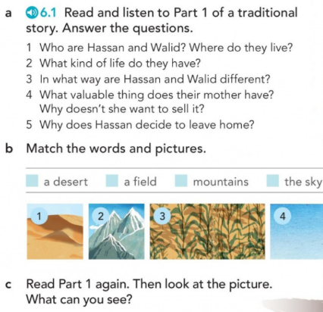
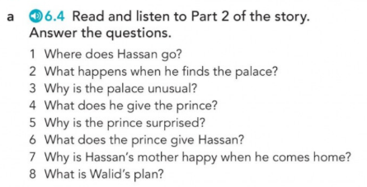
A NORTH AFRICAN STORY
PART 1 PART 2

Slide 7
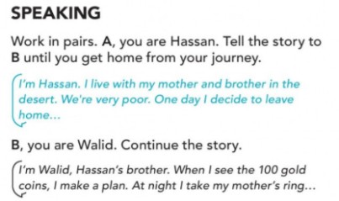
A NORTH AFRICAN STORY

Slide 8
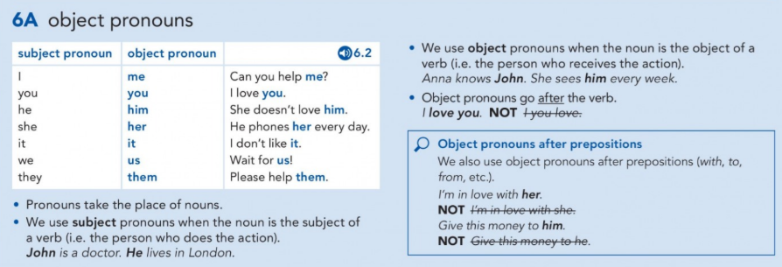
GRAMMAR
134

Slide 9
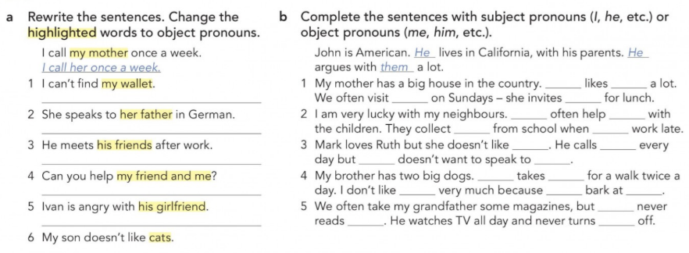
PRACTICE
135

Slide 10
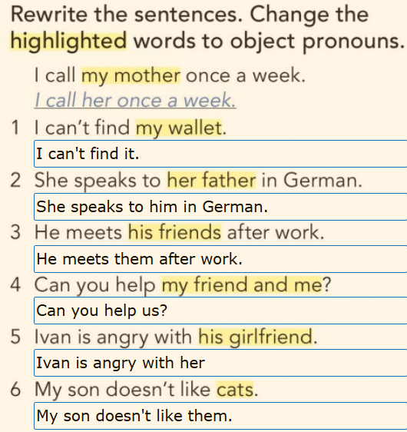
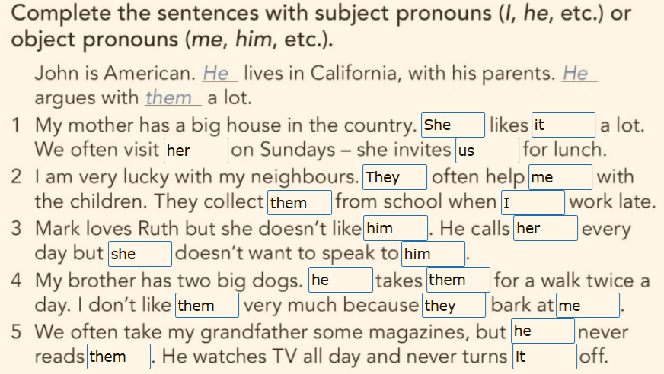
PRACTICE

