Slide 1
DECRIBING SHAPES AND STRUCTURES

Slide 2
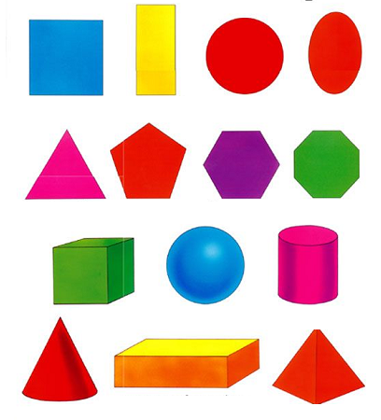
GEOMETRIC SHAPES

Slide 3
GEOMETRIC SHAPES

Slide 4
OTHER WORDS TO DESCRIBE SHAPES AND STRUCTURES…
Symmetrical
Asymmetrical
Dome
Round
Pillar
Curvy
Prism
Arch
Square
Cylinder
Oval
Circle
Ellipse
Rectangle
Triangle
Pentagon
Hexagon
Octagon
Rhombus
Cone
Pyramid

Slide 5
LET’S PUT THIS VOCABULARY WORDS INTO PRACTICE…

Slide 6
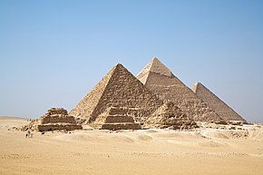
The Pyramids, Egypt

Slide 7
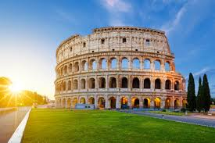
The Colosseum, Italy

Slide 8
The Gherkin, England

Slide 9
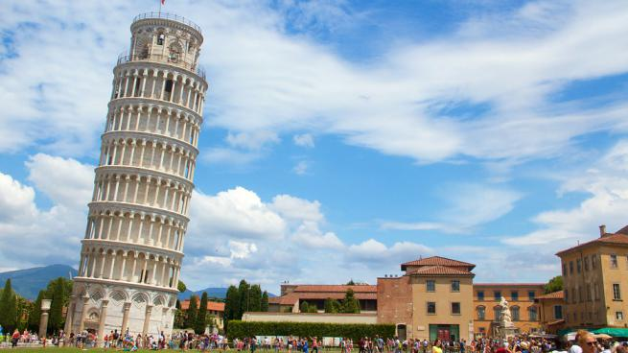
The Tower of Pisa, Italy

Slide 10
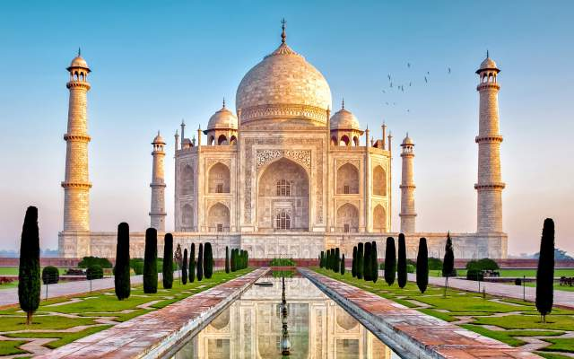
Taj Mahal, India

Slide 11
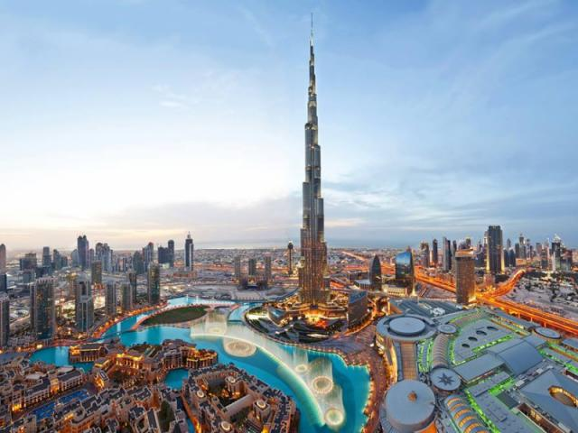
Burj Khalifa, U.A.E.

Slide 12
The Pentagon, USA

Slide 13
The Louvre, France

