Slide 1
4 B
MANNERS

Slide 2
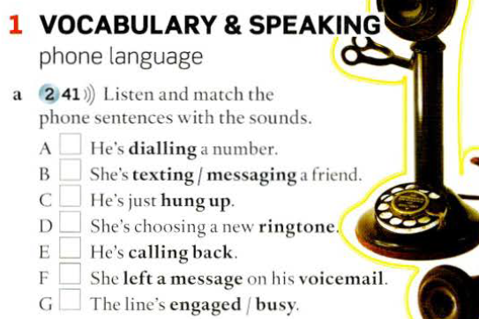
5
7
2
1
6
4
3

Slide 3
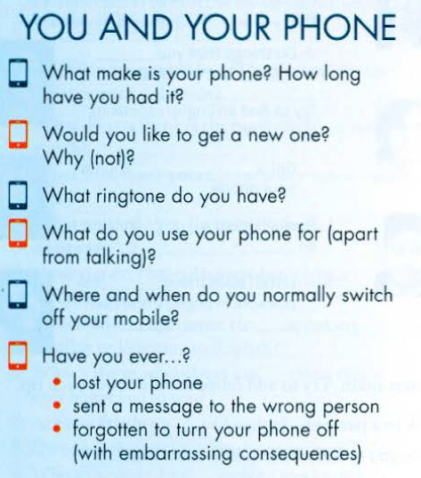

Slide 4
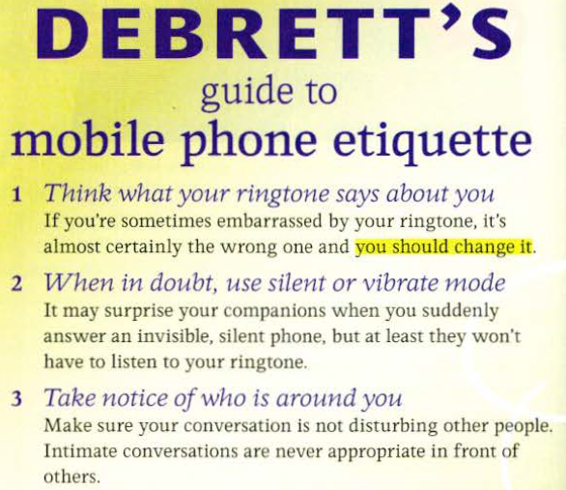
What should you do?

Slide 5
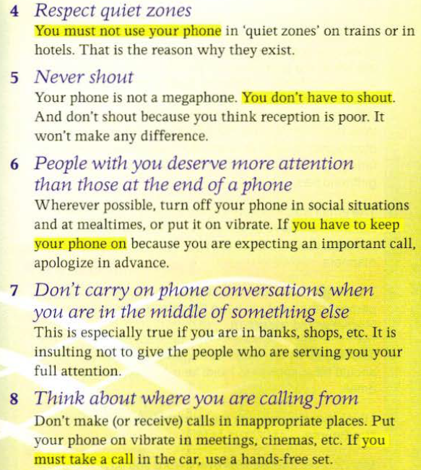

Slide 6
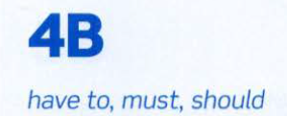
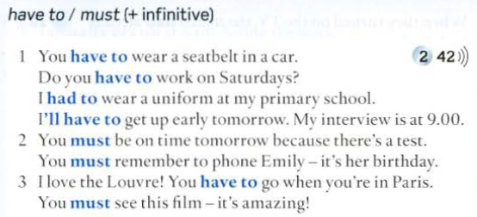
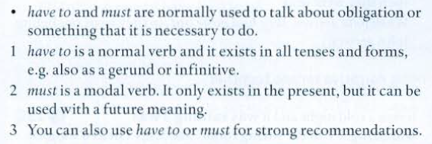

Slide 7
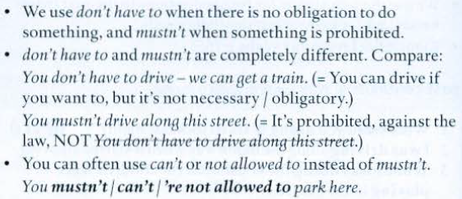

Slide 9
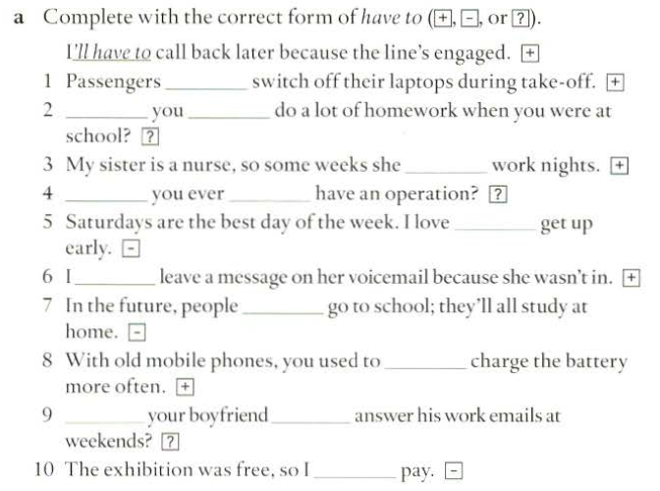
have to
Did
have to
has to
Have
had to
not having to
had to
won’t have to
have to
Does
have to
didn’t have to

Slide 10
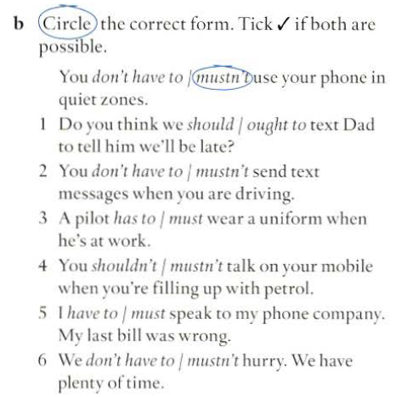

Slide 11
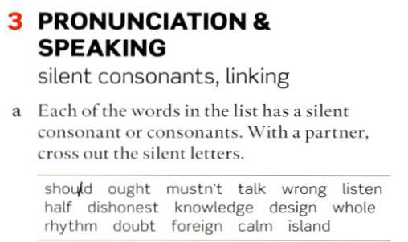
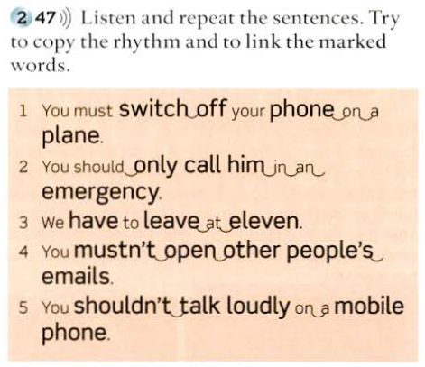
thumb. castle. science, knee. answer, sign, climb. scissors,
exhausted

Slide 12
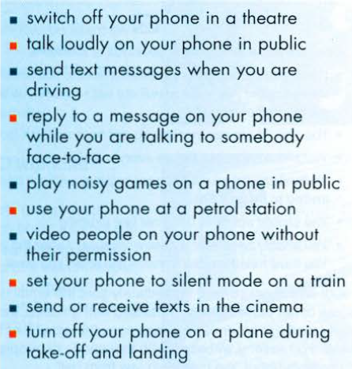
MANNERS
LAWS OR RULES
VS
Make sentences using should/ shouldn't for something which you think is a question of manners, and with must / mustn't / have to for something which is a law or a rule.

Slide 13
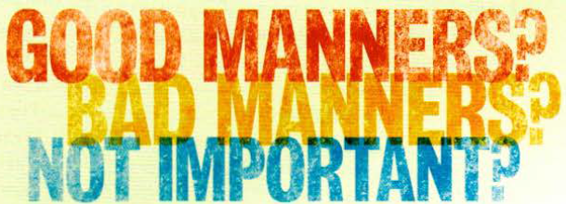
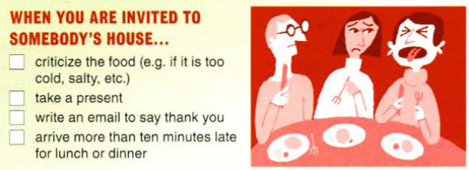
Talk about each thing in the Good Manners questionnaire. Do you think it's good manners. bad manners, or not important / not necessary to …
Example: I think it is very rude to criticize the food if you are in somebody's house
I think it depends. It's OK if you know the person very well or if it's a member of your family ...

Slide 14
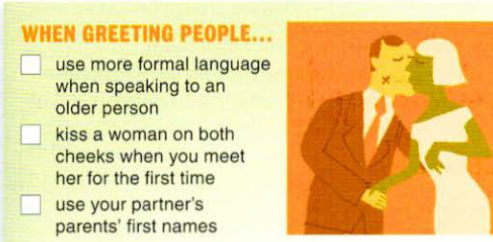

Slide 15
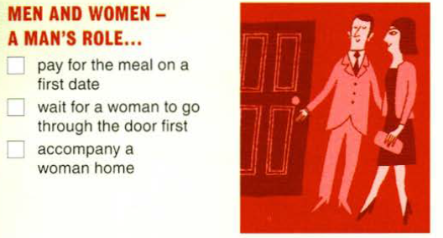

Slide 16
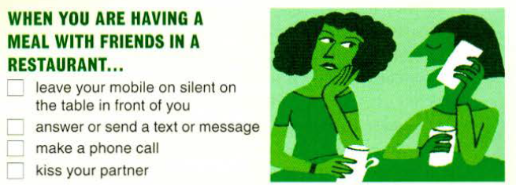

Slide 17
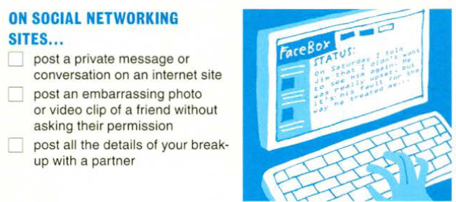

Slide 18
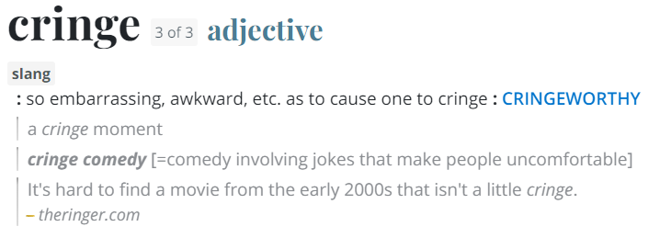
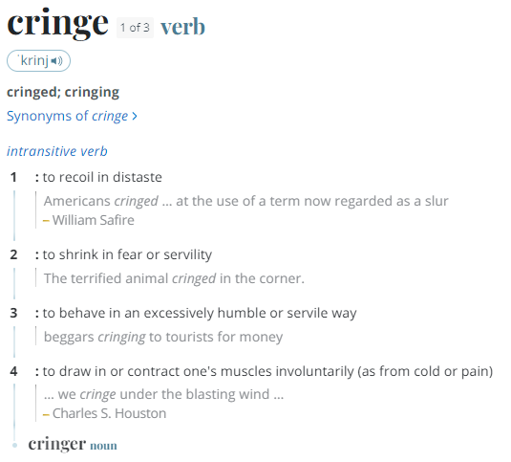
Vicarious embarrasment or
secondhand embarrassment

