Slide 1
6 A
THE CINEMA

Slide 2
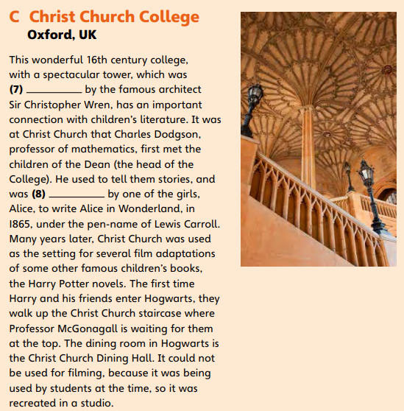
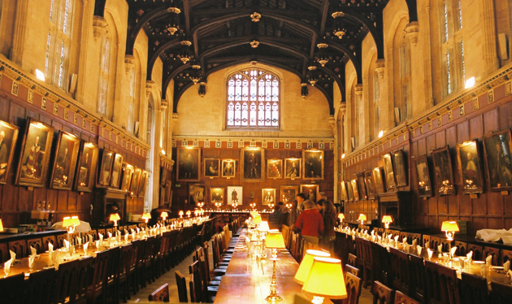
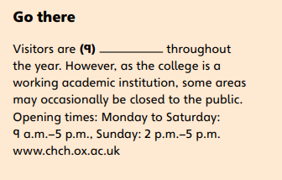
designed
3.25
inspired
welcomed

Slide 3
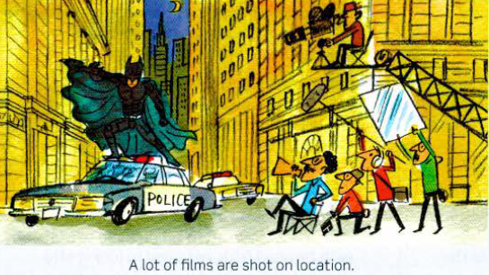
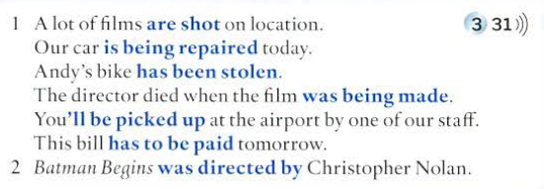
The passive

Slide 4
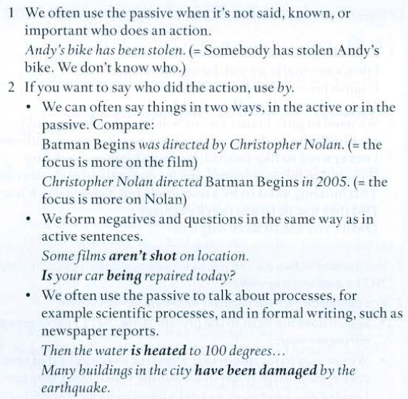
The passive

Slide 5
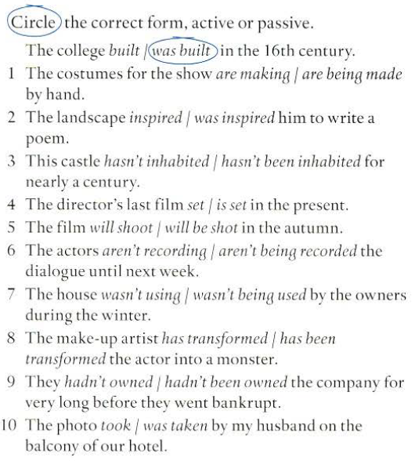
The passive

Slide 6
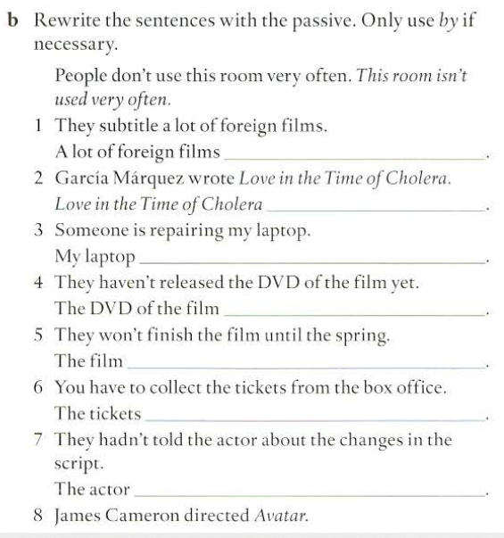
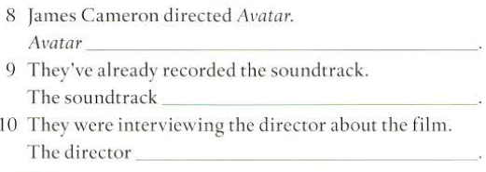
The passive
are subtitled.
was written by García Marquez
is being repaired.
was directed by James Cameron
hasn’t been released yet
has already been recorded.
won’t be finished until the spring
was being interviewed about the film
have to be collected from the box office
hadn’t been told about the changes in the script
Avatar was directed by James Cameron

Slide 7
DICTATION
1 The film is based on a famous book.
2 The house was built in the 16th century.
3 The castle has been visited by thousands of tourists.
4 The hall couldn't be used for filming.
5 Where is it being filmed?
6 Who was it written by?

