Slide 1
3 A
RACE ACROSS LONDON

Slide 3
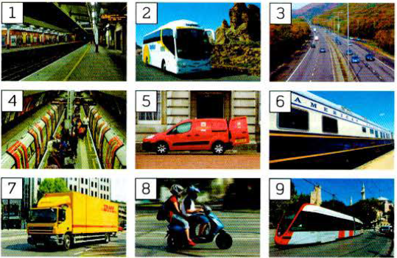
platform
coach
motorway
the underground
AmE subway
van
carriage
Lorry /truck AmE
tram
scooter

Slide 5
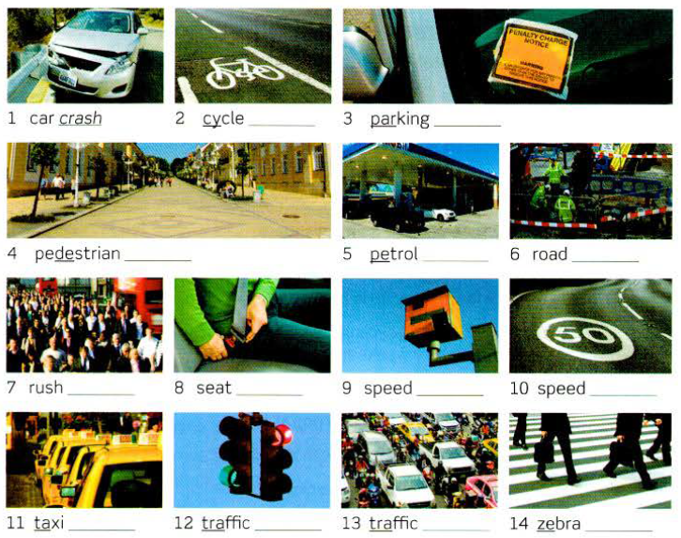
lane
fine
zone
station
works
hour
belt
camera
limit
rank
lights
jam
crossing

Slide 6
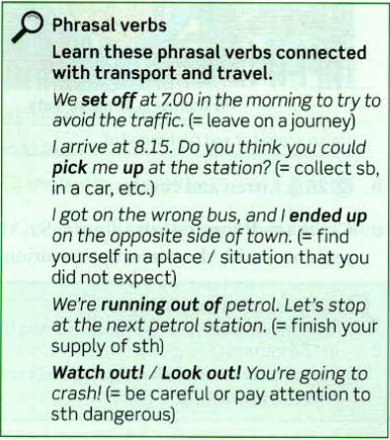
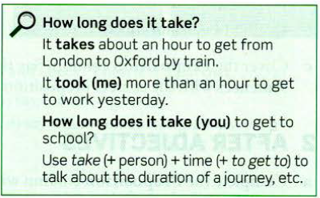

Slide 7
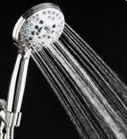
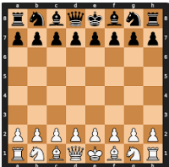
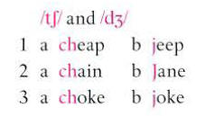
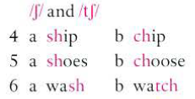
shower
jazz
chess
crash
rush
station
bridge
journey
traffic jam
adventure
catch
coach

