Slide 1
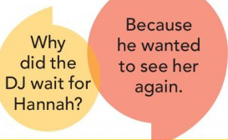

Slide 2
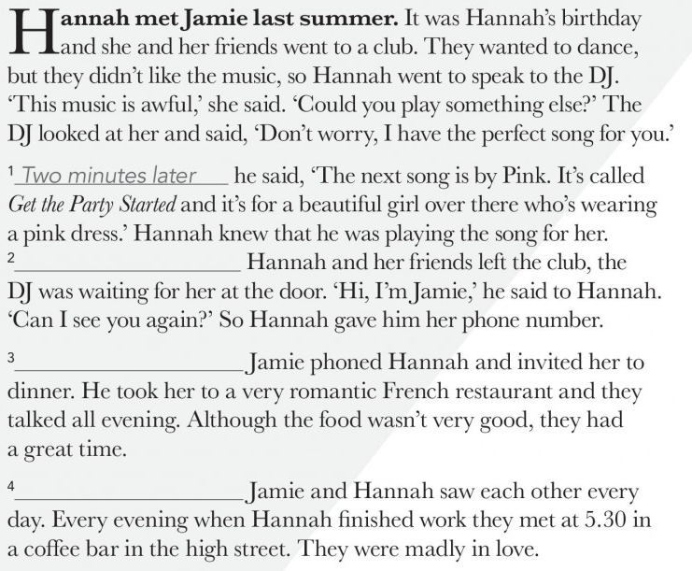
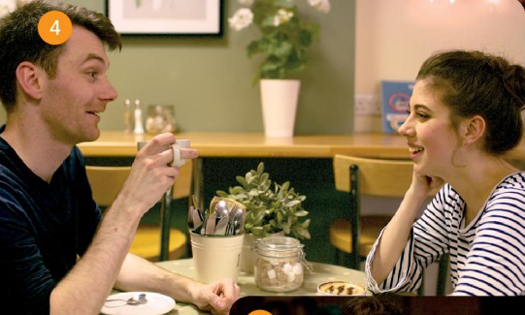
When
The next day,
After that

Slide 3
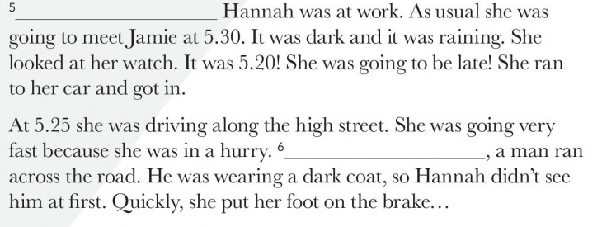
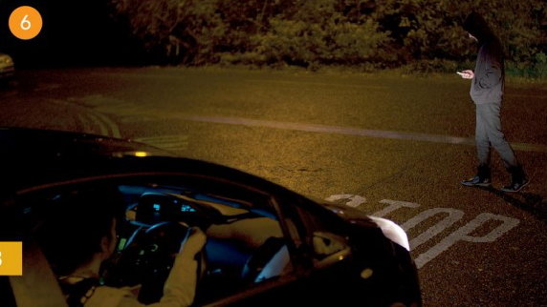
One afternoon in October
2.00
Suddenly

Slide 4
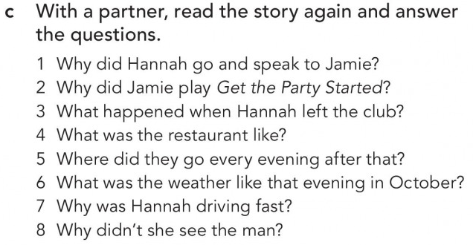

Slide 7
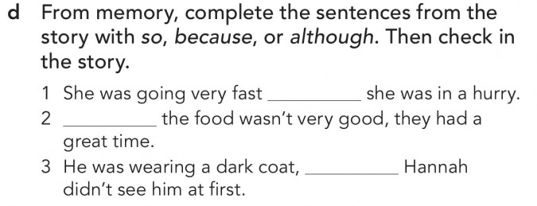
because
Although
so

Slide 9
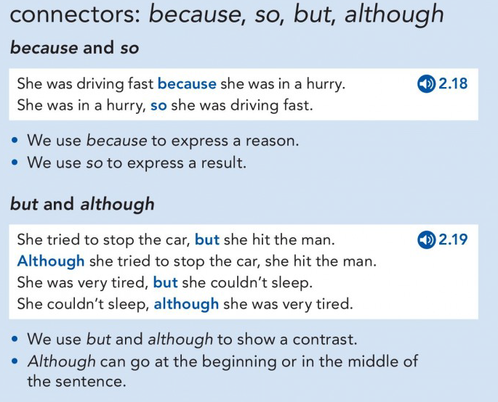

Slide 10
5
3
8
4
6
2
7

Slide 11
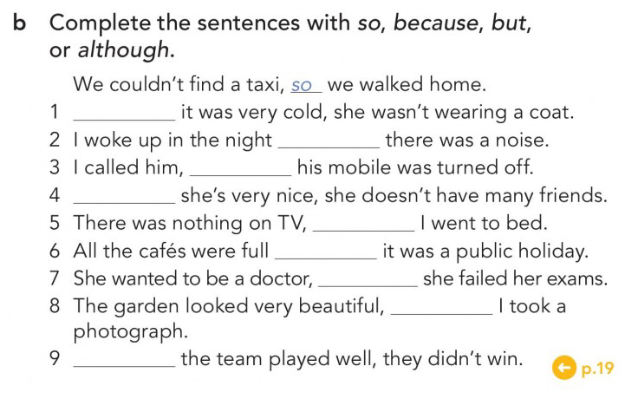
Although
because
but
Although
so
because
but
so
Although

Slide 12
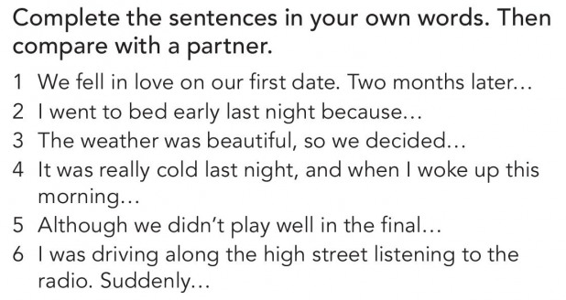

Slide 13
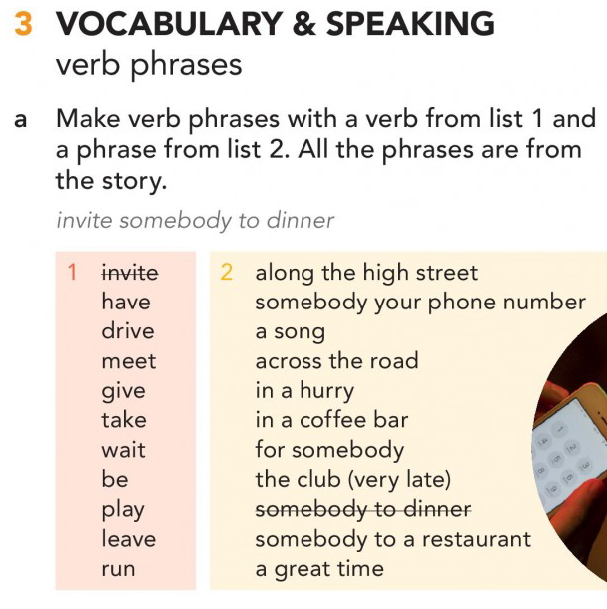

Slide 15
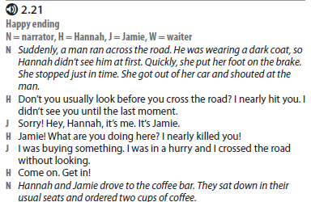
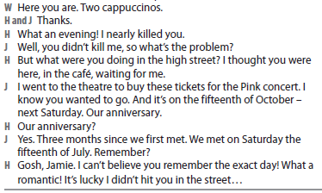
HAPPY ENDING

Slide 16
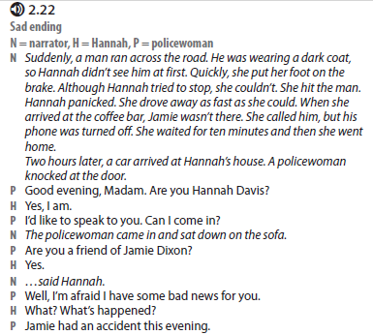
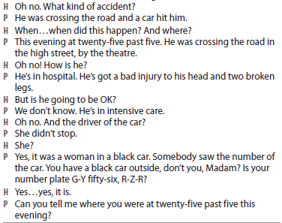
SAD ENDING

Slide 17
https://elt.oup.com/student/englishfile/preint3/grammar/file02/grammar02_c01?cc=ar&selLanguage=en
https://elt.oup.com/student/englishfile/preint3/grammar/file02/grammar02_c02?cc=ar&selLanguage=en

