Slide 1
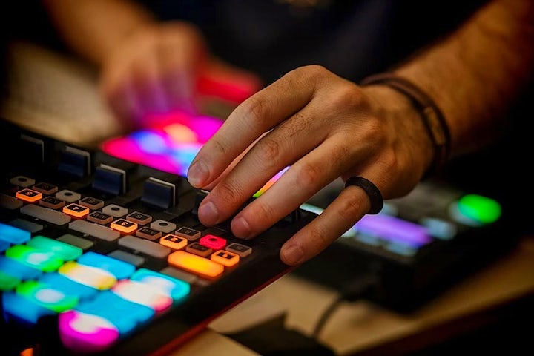
6C
MAKING MUSIC

Slide 2
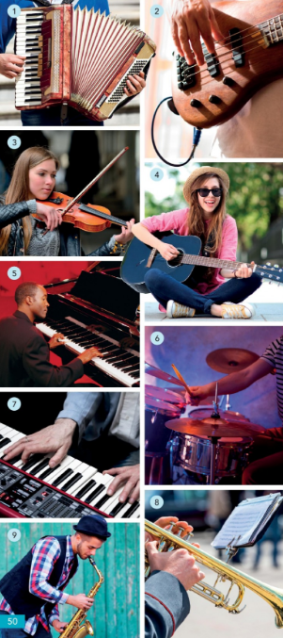
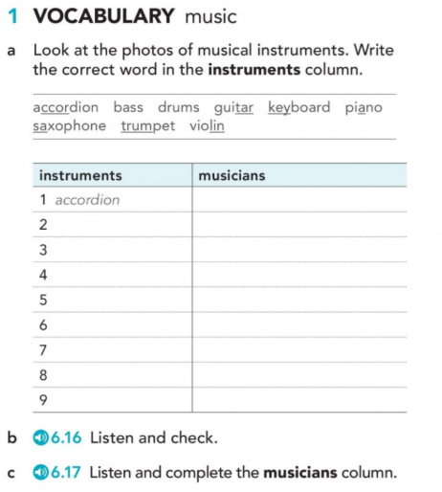
Page 50

Slide 3
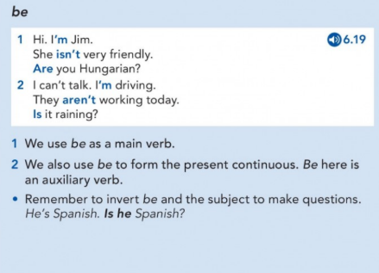
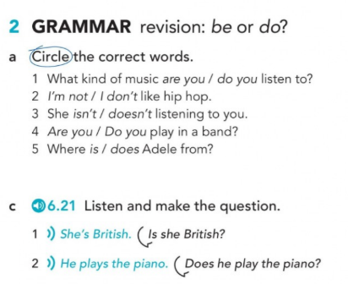
Page 50
Page 134

Slide 4
YES/NO questions with TO BE
Is | your mother | at home?
Is | the series | interesting?
Are | these series | interesting?
Is | your house | big?

Slide 5
WH questions with TO BE
What | is | your favourite song?
What day | is | the concert?
What | is | your favourite instrument?
Who | is | her favourite singer?

Slide 6
What | is | this?
What | are | those?
What | is | your email address?
What lesson | is | this?

Slide 7
Where | is | your surname from?
Where | are | my glasses?
When | is | the English class?
What time | is | our English class?

Slide 8
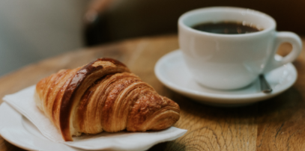
How | are | you ?
How old | are | you ?
How much | is | a coffee and a croissant?

Slide 9
Questions with WHAT …BE…LIKE
What | is | the weather | like today ?
What | is | your best friend | like?
What | are | the people/the streets/the houses | like in Mendoza?
What | is | autumn | like in Mendoza?

Slide 10
YES/NO questions with DO
Do | you | like | singing?
Do | they | love | Music?
Does | he | play | tennis?
Does | Tini | sing | in English?

Slide 11
WH questions with DO
How | do | you | spell | your name ?
How many brothers and sisters | do | you | have | ?
How | do | you | do | ?

Slide 12
WH questions with DO
What | do | you | do?
What food | do | you | like?
What kind of books | do | you | read?
What TV programmes | do | you | watch?

Slide 13
Now and around now – Present Continuous
What | are | you | doing | right now?
What exams | are | you | taking | these days?
What | is | Peter | wearing | today?
What kind of music | are | they | listening to | at the moment?
What subjects | are | they | attending | this semester?

Slide 14
Present Simple
Are | you | _ | a student?
Does | Maria | do | housework?
Do | the students | study | a lot?
Is | Tini | - | A good Singer?

Slide 15
Now and around now. Present Continuous
Are | you | reading | a book right now?
Is | Maria | doing | Housework today?
Are | the students | sitting | for an exam right now?
Are | they | going | home now?

Slide 16
Are you here? Yes, I am. No, I’m not.
Am I here?
Are they here?
Is she here?
Is he here?
Is it here?
The students, your mother, my husband, the people in the office
The interesting books, the musicians, Autumn, the museum,
The computers, my neighbour, your neighbours, the houses, the photos on your cell phone, the members of your family.
BE: Yes/No questions

Slide 17
Do you read a lot? Yes, I do. No, I don’t.
Do I read a lot?
Do they read a lot?
Does she read?
Does he read?
Does it work? Does it have a garden?
The students, your mother, my husband, the people in the office, the musicians, the museum, The computers, my neighbour, your neighbours, the houses, your cell phone, the members of your family, etc.
DO: Yes/No questions

Slide 18
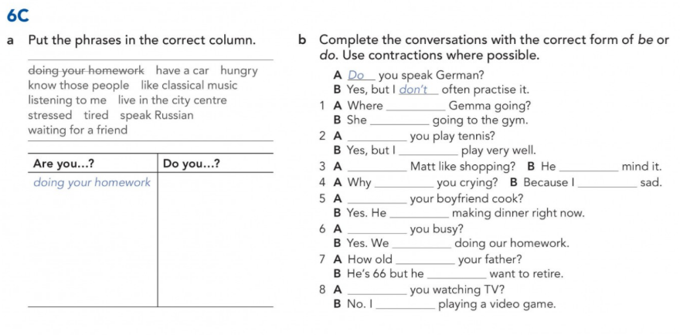
LET’S PRACTICE
Page 135

Slide 19
LET’S CHECK
Page 135
is
is
Do
don’t
Does doesn’t
are am
hungry
listening to me
stressed
tired
waiting for a friend
have a car
know those people
like classical music
live in the city centre
speak Russian
Does
is
Are
are
is
doesn’t
Are
am

Slide 20
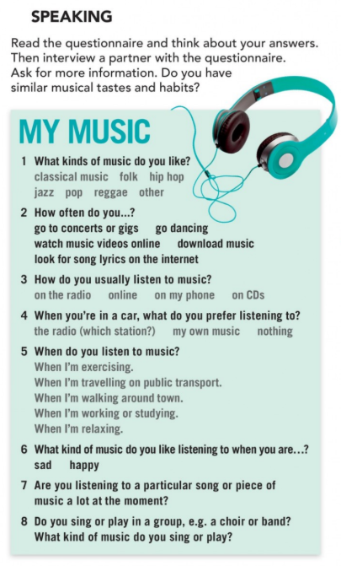
Page 51

