Slide 1
7A
AT THE NATIONAL PORTRAIT GALLERY

Slide 2
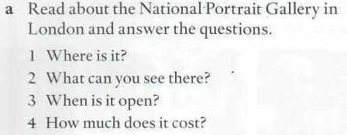

Slide 3
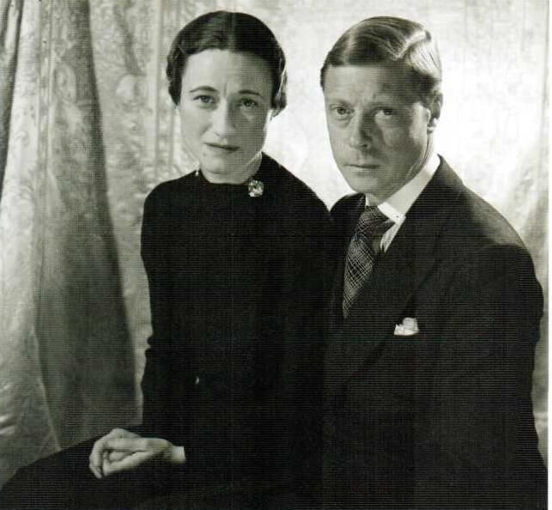
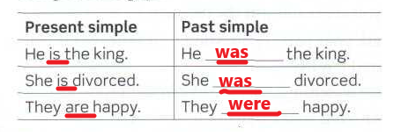

Slide 4
PAST SIMPLE VERB BE

Slide 7
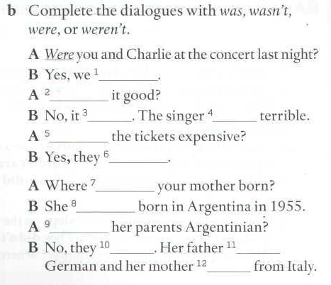
BE BORN
Where were you born?
When were you born?
Where was your father/mother born?
Where were your grandparents born?
When was your best friend born?

Slide 8
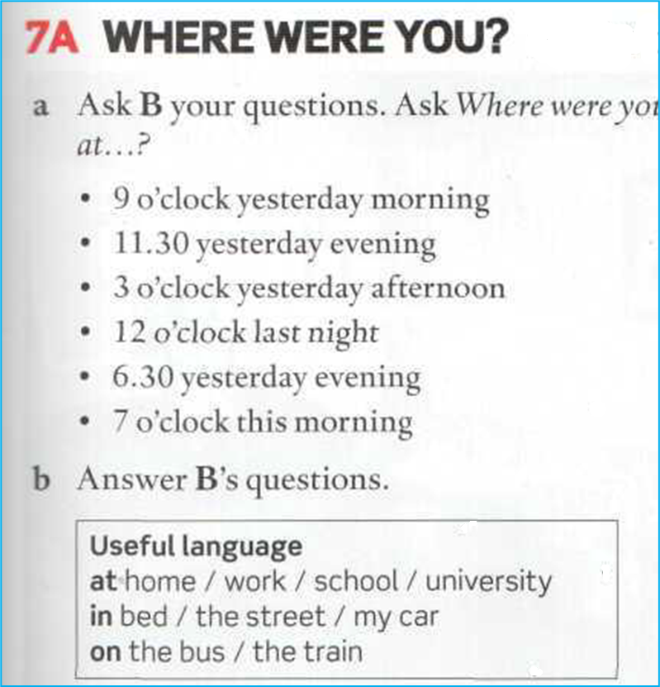
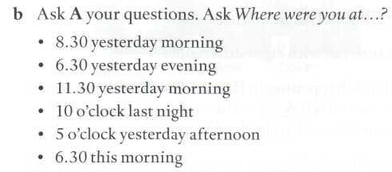
WHERE WERE YOU YESTERDAY?
ORAL ASSIGNMENT

