Slide 1
7B
IDEAL HOME

Slide 2
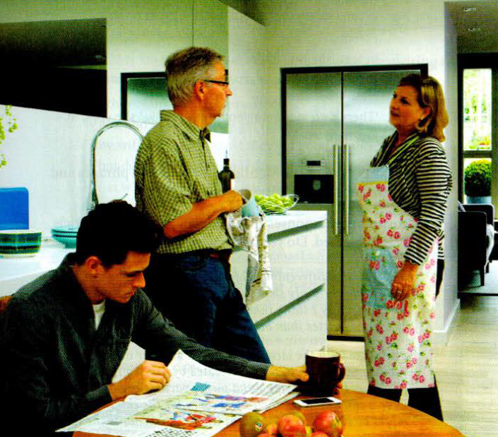
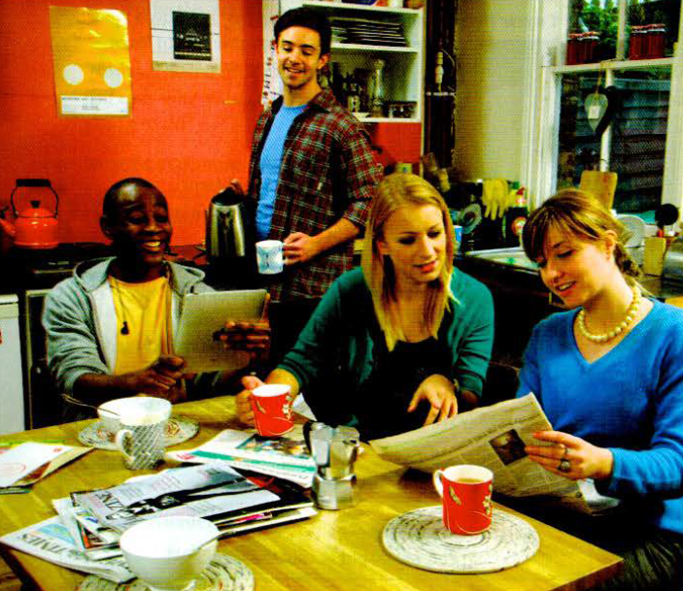

Slide 3
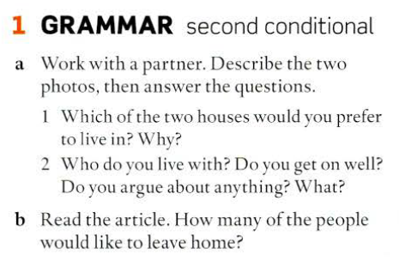
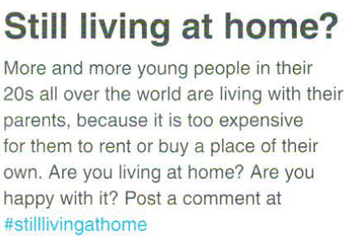
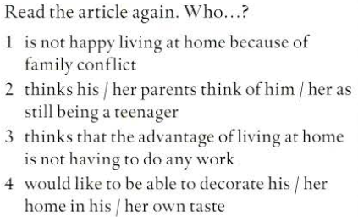

Slide 4
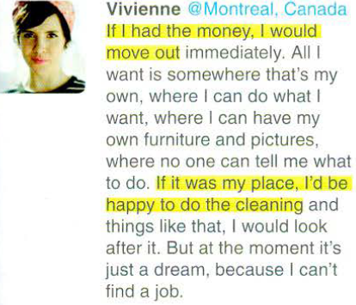
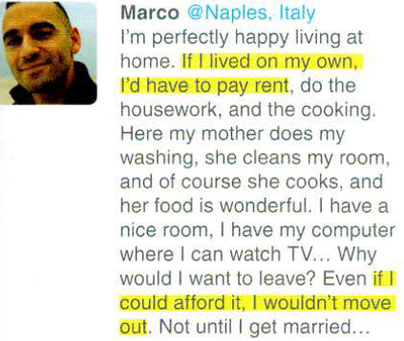
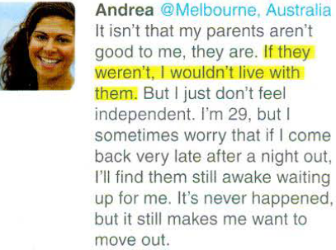
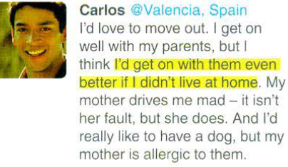
Do you still live with your parents?
Do you agree with any of the writers?

Slide 5
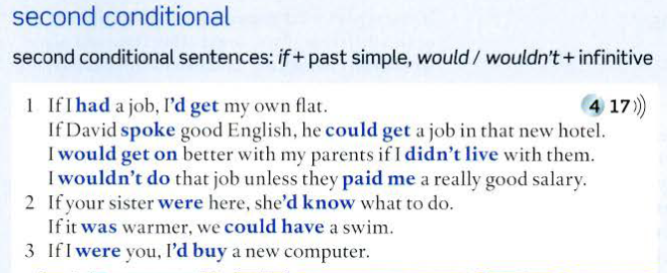
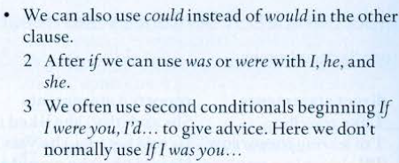

Slide 6
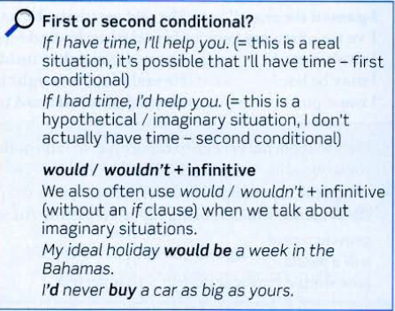
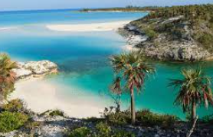
WHAT WOULD YOUR IDEAL HOLIDAY BE?

Slide 7
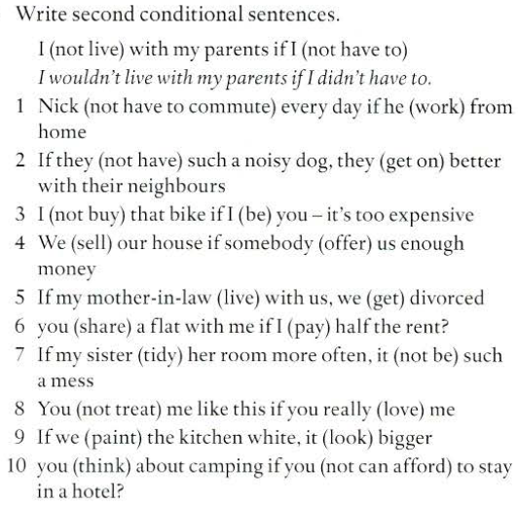

Slide 8
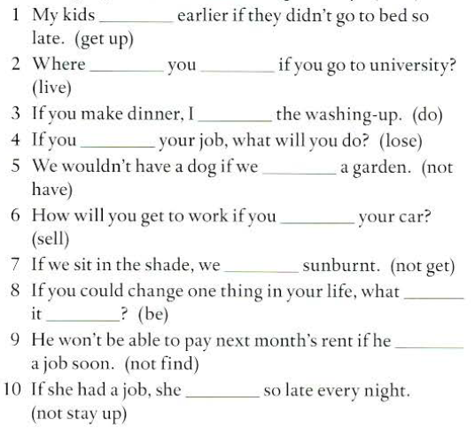
First or second
Conditional
?
would get up
will
live
‘ll do
lose
didn’t have
sell
won’t get
would
be
doesn’t find
would’t stay up

Slide 9
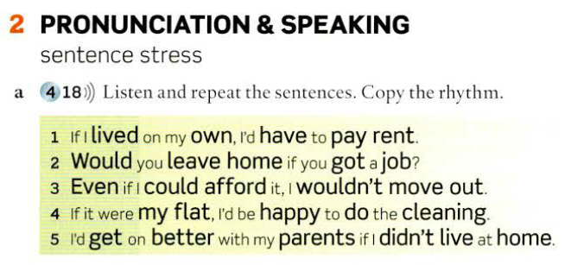

Slide 10
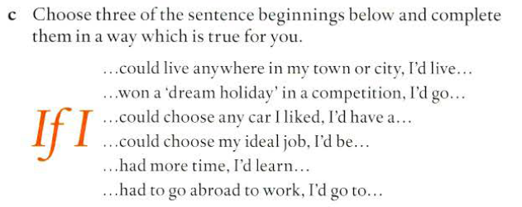

Slide 11
1 I'd cook dinner every day if I
2 If we didn't go on holiday this summer, maybe we
3 I think you would enjoy the film more if
4 I'd see my grandparents more often if they
5 I wouldn't have the fish if I …It isn't usually very good here.
6 l 'd go swimming if the water
got home earlier from work.
couId afford to get a new car.
you saw the original version.
lived nearer.
were you.
was a bit warmer.

Slide 12
7 The house would look better if
8 If I met my ex in the street, I wouldn't
9 If it wasn't so late, I'd
10 The flight would be more comfortable if
11 I wouldn't mind the winter so much if it
12 If I had more money,
you painted it.
say hello to him.
stay a bit longer.
we were in business class.
didn't get dark so early.
I'd buy a house with a beautiful garden .

Slide 13
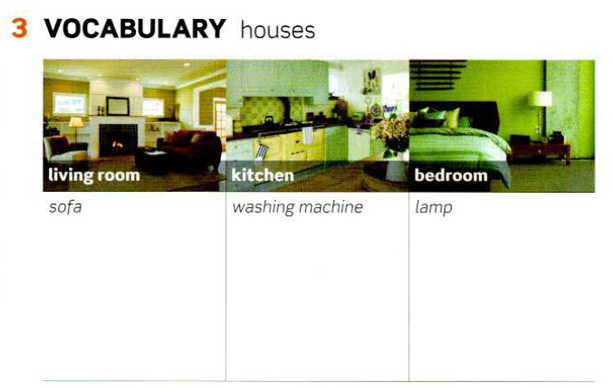

Slide 14
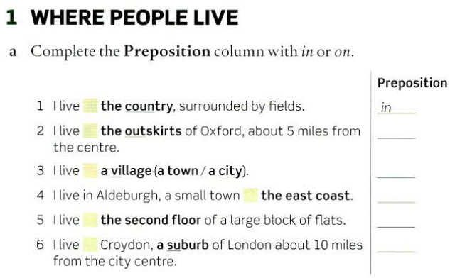
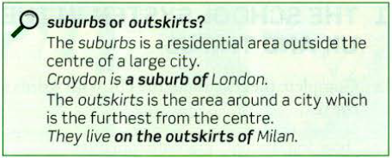
in
on
in
on
on
in

Slide 15
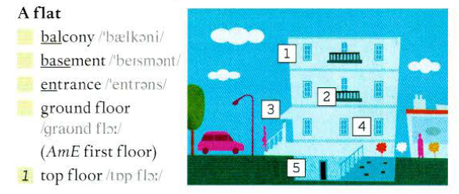
2
5
3
4

Slide 16
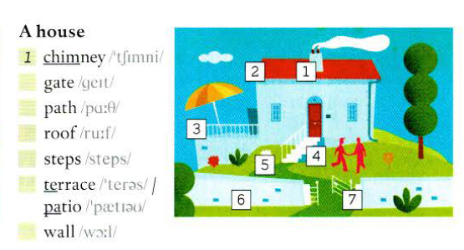
0.32
7
5
2
4
3
6

Slide 17
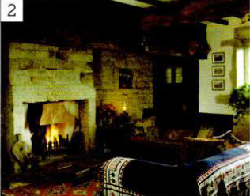
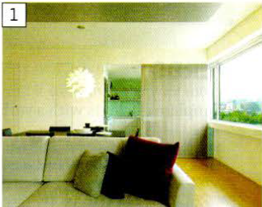

Slide 18
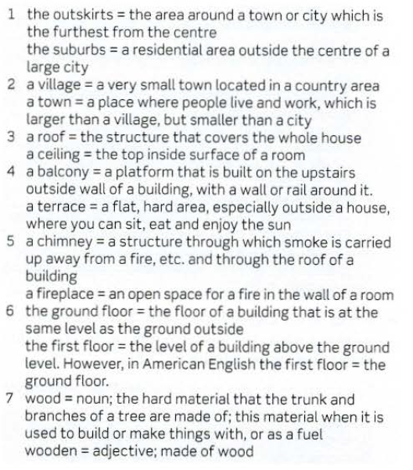

Slide 19
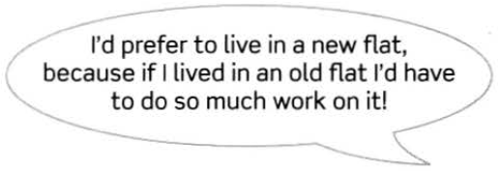
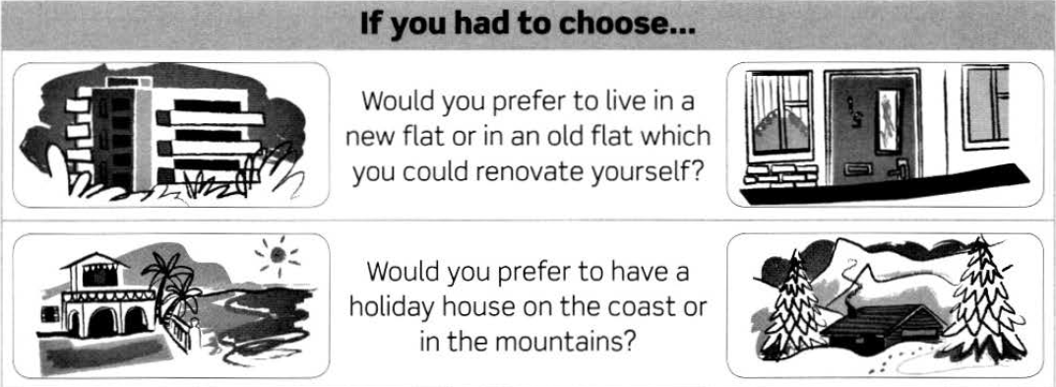
If you had to choose…

Slide 20
If you had to choose…

Slide 21
If you had to choose…

Slide 22
If you had to choose…

Slide 23
LISTENING & SPEAKING
Listen to four American architecture students describing their 'dream house'. Which speaker's house is .. . ?
the most hi-tech the most luxurious the most eco-friendly the most romantic
1
My dream house would be in one of our national parks like Yellowstone or Redwood. It would be totally green - I'd have solar panels and wind turbines, and I'd collect rainwater. The house would be made of wood and would be heated by wood fires. I would try to live off the land as much as possible and I'd plant vegetables and fruit, and maybe have chickens. It would all be organic, with no pesticides or anything like that.
2
My dream house would be in Paris. It 'd be on the top floor of an old apartment building and I'd have a view of the Eiffel Tower or Notre Dame. It would be full of furniture that I'd found in antiques markets, places like that, and amazing paintings, one of which would turn out to be an undiscovered Picasso or Matisse. There would be a beautiful old dining table and chairs for candlelit dinners ... then all I'd need would be the right person to share it with.
3
My dream house would be a flat in SoHo in New York It wouldn't be too big, it 'd just have a couple of bedrooms, and
a huge living room with a home cinema. It would be very modern and incredibly practical, with things like automatic
temperature control, a kitchen with all the latest gadgets – if possible, a stove that would produce amazing meals on its own - I'm a lazy kind of guy.
4
If I had to choose where to live, I'd choose Hawaii. So my dream house would be made of glass with the most amazing view of the beach from every room in the house, and it'd have indoor and outdoor pools, and maybe a tennis court - I'm
quite sporty. It would also have a big indoor aquarium. There's something so peaceful about looking at fish. And fabulous
bathrooms of course.

