Slide 1
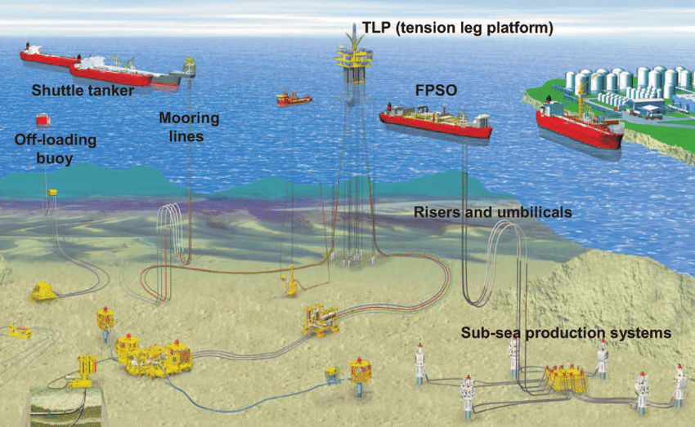
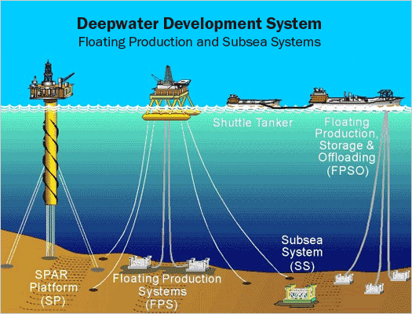
Offshore Production 4
Ing. Lourdes Guiñazu

Slide 2
Agenda
Instalation Integrity
Process Control
Critical Operations
Umbilical

Slide 3
Installation Integrity

Slide 4
Installation Integrity

Slide 5
Installation Integrity

Slide 6
Installation Integrity

Slide 7
Critical Operations

Slide 8
Process Control

Slide 9
Process Control

