Slide 1
Unit 4 and UNIT 9B
ORAL PRACTICE

Slide 2
SIMPLE PAST

Slide 3
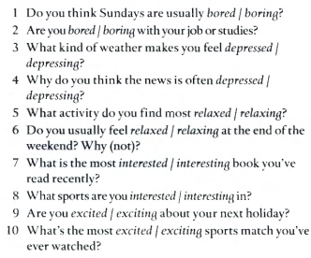
VOCABULARY
1- boring – 2- bored – 3- depressed – 4- depressing – 5- relaxing – 6-relaxed- 7-interesting 8- interested 9- excited - 10- exciting
1- SELECT THE CORRECT OPTION TO COMPLETE THE QUESTIONS
2-ASK AND ANSWER THE QUESTIONS ORALLY

Slide 4
PRESENT PERFECT
https://www.youtube.com/watch?v=fXN8hY0WwGg
https://www.youtube.com/watch?v=0tNdyeL8qLU
https://elt.oup.com/student/englishfile/preint3/grammar/file04/grammar04_b01?cc=ar&selLanguage=en
https://www.myenglishpages.com/site_php_files/grammar-exercise-already-since-for-yet-just.php

Slide 5
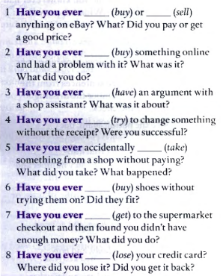
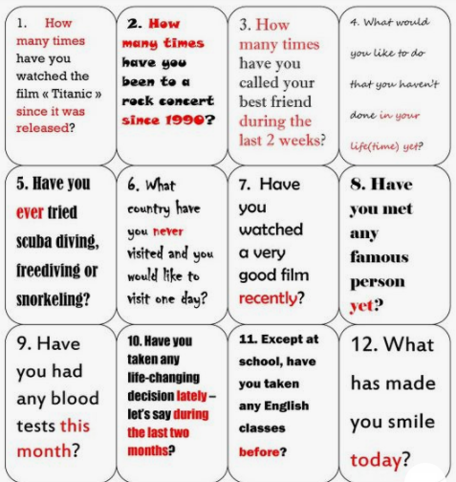
PRESENT PERFECT
1-ASK AND ANSWER THE QUESTIONS ORALLY

Slide 6
PRESENT PERFECT
1- COMPLETE THE QUESTIONS
2-ASK AND ANSWER THE QUESTIONS ORALLY

Slide 8
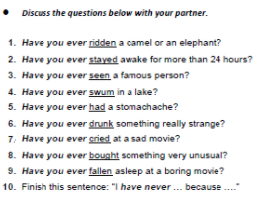

Slide 9
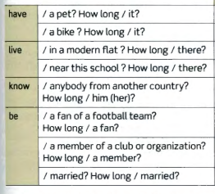
PRESENT PERFECT VS. SIMPLE PAST
1- COMPLETE THE QUESTIONS
2-ASK AND ANSWER THE QUESTIONS ORALLY

Slide 10
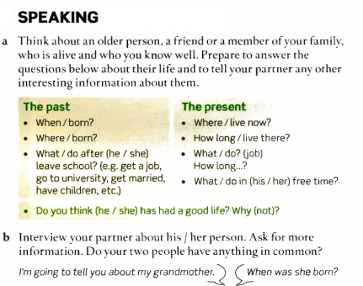
PRESENT PERFECT, SIMPLE PAST AND PRESENT SIMPLE

Slide 11
ASSIGNMENTS
1, 2, 3
4 (page 113, write an informal e-mail)
OFFICE HOURS: WEDNESDAY, NOVEMBER, 11TH 5-6 pm

Slide 12
MIDTERM TEST
November, 16th 12am - 2pm
Camara and microphone

