Slide 1
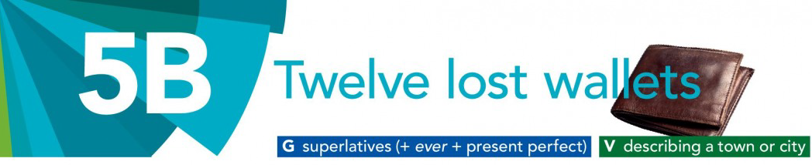
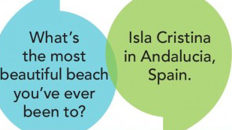

Slide 2
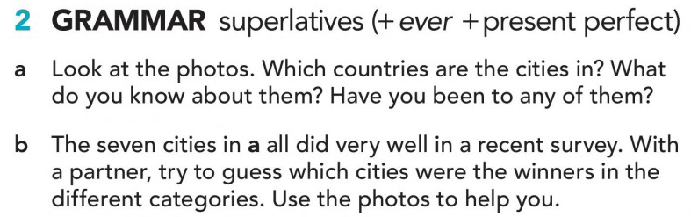
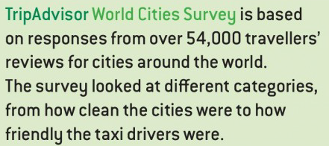
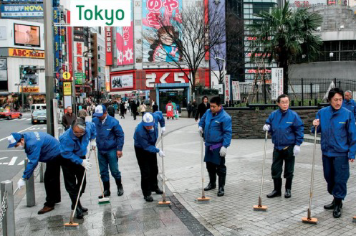
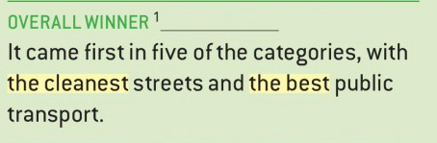

Tokyo
Tokyo is the cleanest capital city in the world.

Slide 3
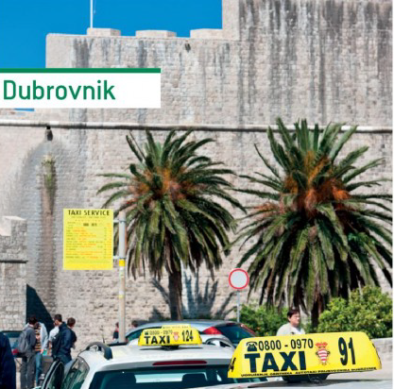
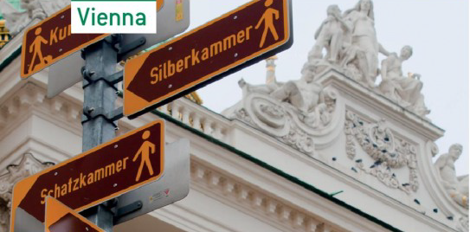
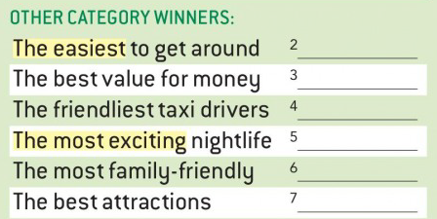



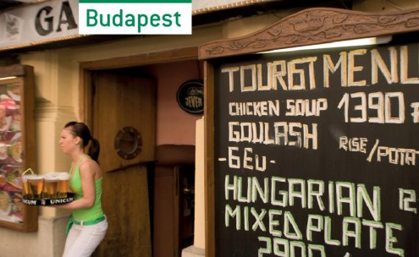



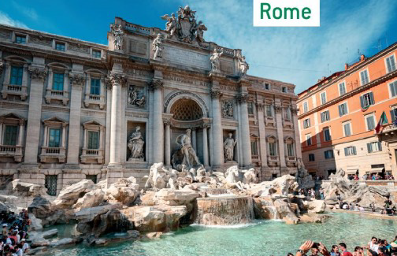

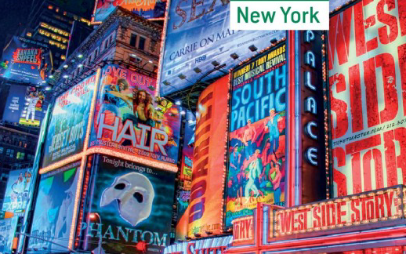
Argentina? Mendoza? Your town?

Slide 4
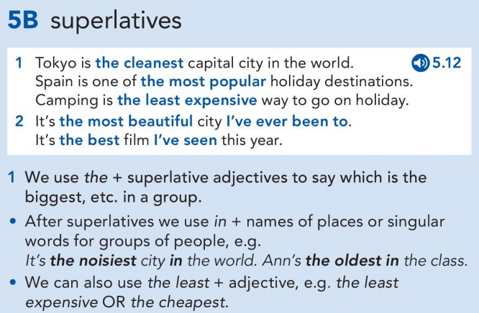


Slide 5
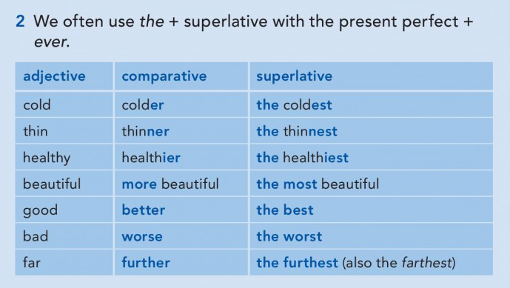

Slide 6
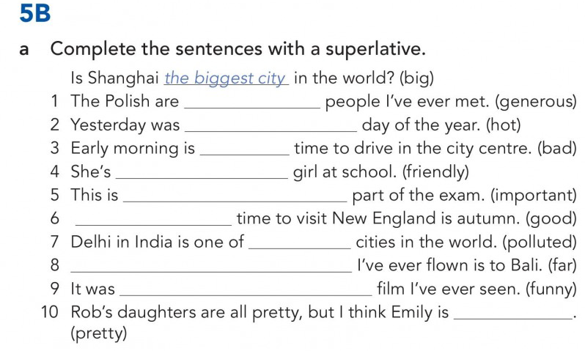
the most generous
the hottest
the worst
The friendliest
the most important
The best
the most polluted
The furthest/ the farthest
the funniest
the prettiest

Slide 7
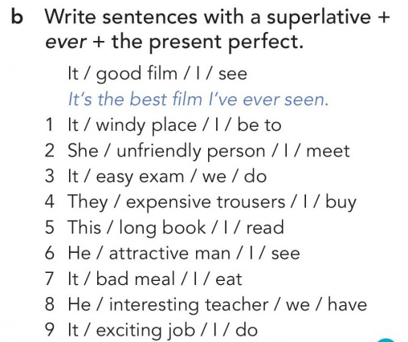
It’s the windiest place I’ve ever been to
She is the most unfriendly person I’ve ever met.
It’s the easiest exam we have ever done
They are the most expensive trousers I’ve ever bought.
This is the longest book I’ve ever read.
He is the most attractive man I’ve ever seen.
It’s the worst meal I’ve ever eaten.
He is the most interesting teacher we’ve ever had.
It’s the most exciting job I’ve ever done.

Slide 8
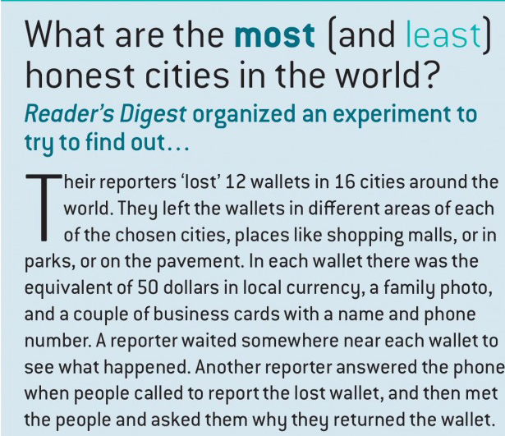
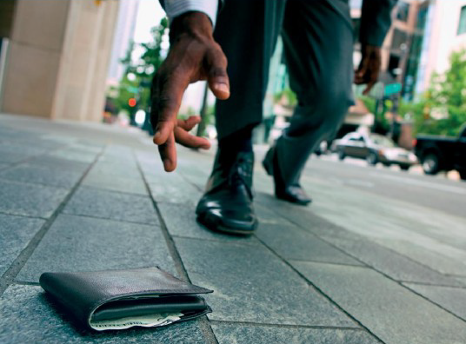

Slide 9
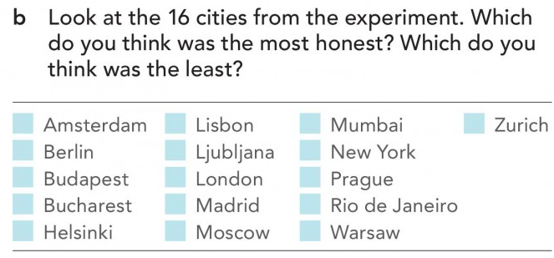
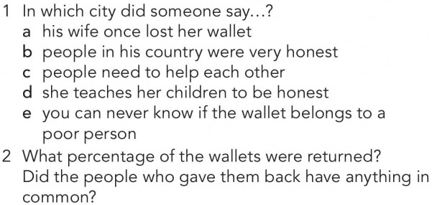
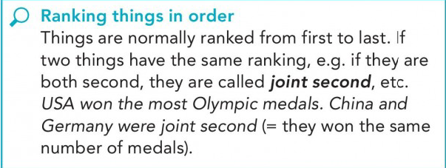

Slide 10
ANSWERS
5
16
2
3
3
9
1
5
9
AMSTERDAM
HELSINKI
MOSCOW
MUMBAI
LONDON
47%

Slide 11
I Today we’re talking about a very interesting experiment to find the most and least honest cities in the world. It involved journalists travelling to 16 cities and ‘losing’ 12 wallets in each city, then waiting to see how many people returned them in each place. Our presenter Oliver has got the results. So, Oliver, which was the most honest city?
O Well, in first place was Helsinki, in Finland. People returned 11 of the 12 wallets. A businessman, who found the wallet in the city centre, said that Finnish people were naturally honest. He said there was very little corruption in Finland, and that people didn’t even drive through red traffic lights!
I Really? And the least honest?
O Well, I was quite surprised by this, but the least honest city, in 16th place, was Lisbon in Portugal. Only one person phoned to say they’d found the wallet. And he wasn’t Portuguese, he was a 60-year-old tourist from Holland.
I Interesting! What other results surprised you?
O Well, I expected richer cities, cities with a higher standard of living, to be more honest than poorer ones, but this wasn’t necessarily true. The city that came second in the experiment was Mumbai in India – people returned 9 out of the 12 wallets. One of them was a young mother. She took it to a post office and she said ‘I teach my children to be honest, just like my parents taught me.’
I And which city came next?
O In joint third place were New York and Budapest. People gave back 8 wallets in both places.
I And then?
O Moscow and Amsterdam came joint 5th. In both places 7 out of 12 wallets were returned. And people gave lovely reasons for returning them. In Moscow a woman said ‘I think that people need to help each other, and if I can make someone a little happier, I want to do it.’ And in Amsterdam a man said ‘My wife once lost her wallet. It was found and returned. So I wanted to do the same.’
I I notice my home city, London, is on the list. How did it do?
O London was somewhere in the middle, joint 9th with Warsaw. Just 5 of the wallets were returned in each place. Interestingly one of the people who returned a wallet in London was a Polish woman. When she found the wallet, she gave it to her boss. He – her boss – said to her, ‘if you find money you can’t be sure it belongs to a rich man – it might be the last bit of money a mother has to feed her family.’
I I think that’s fantastic advice. So were there any general conclusions? What did the experiment prove?
O 47 per cent of the wallets were returned, so that’s nearly half. And when we looked through the results we found that you couldn’t predict who was going to be honest or dishonest. There was no common factor. Young people and old people both kept or returned wallets; men and women both kept or returned wallets; and as I said before, it didn’t make any difference whether a city was rich or poor. So our conclusion was that there are honest and dishonest people everywhere.

Slide 12
1 What’s the most beautiful city you’ve ever been to?
2 What’s the most relaxing holiday you’ve ever had?
3 What’s the most frightening film you’ve ever seen?
4 What’s the most exciting sporting event you’ve ever watched?
5 What’s the most expensive thing you’ve ever bought?
6 Who’s the most generous person you’ve ever met?
7 What’s the most dangerous sport you’ve ever done?
8 What’s the most difficult subject you’ve ever studied?

Slide 13

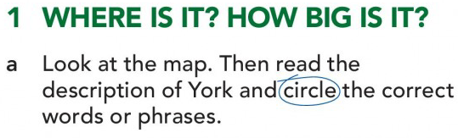
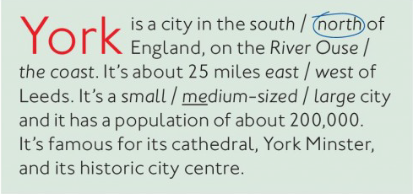
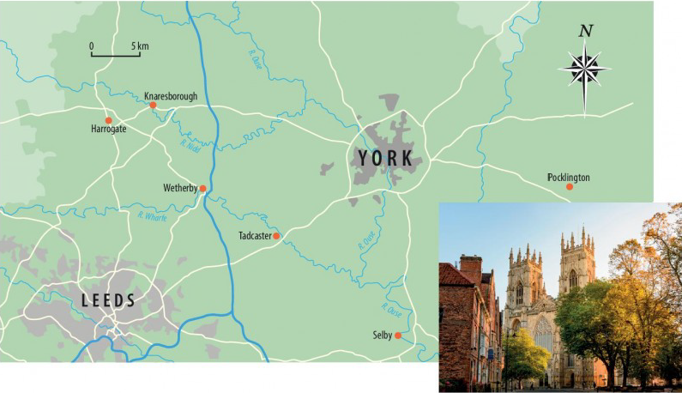

Slide 14

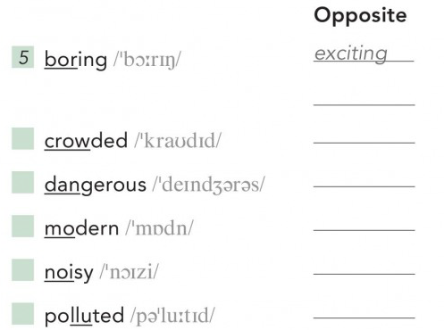
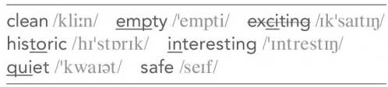





Slide 15
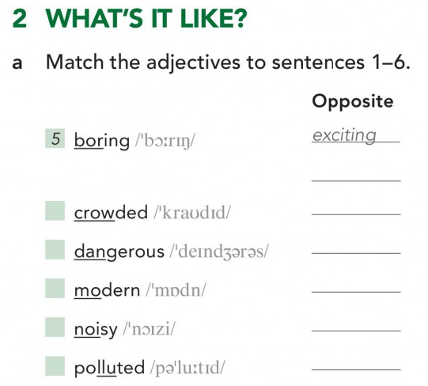
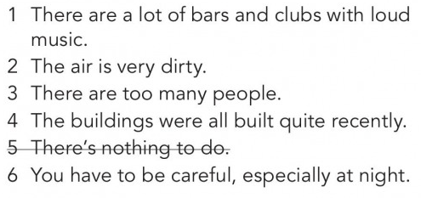

Slide 16
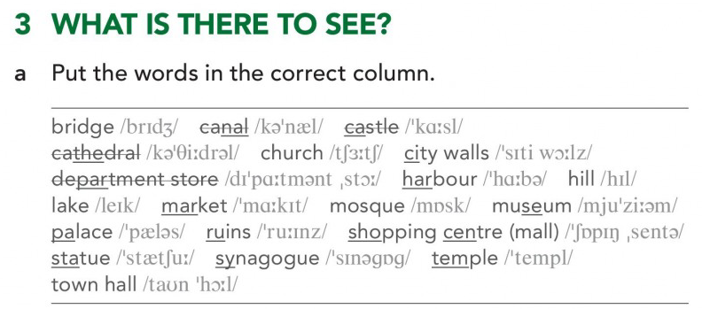
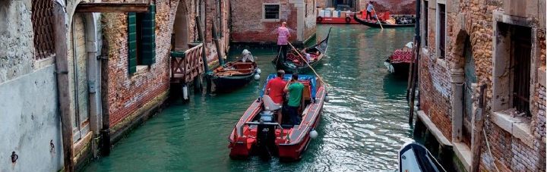
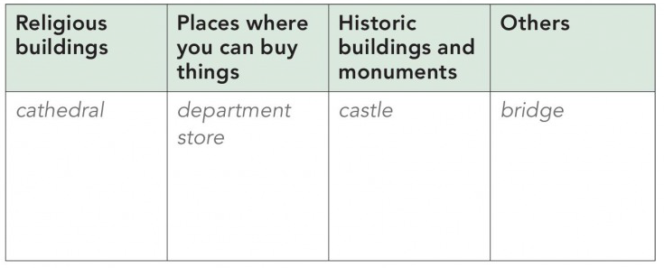
cathedral
church
mosque
synagogue
temple
department store
market
shopping centre
castle
city walls
museum
palace , ruins
Statue,
town hall
bridge
canal
harbour
hill
lake

Slide 17
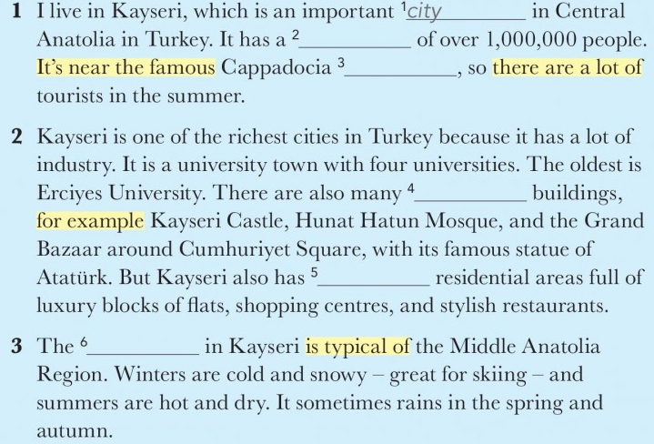

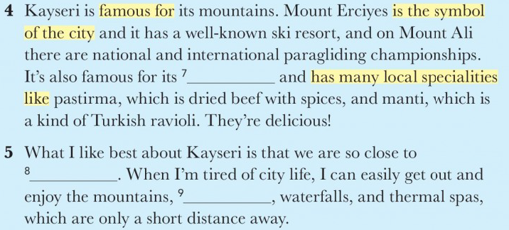

Slide 18



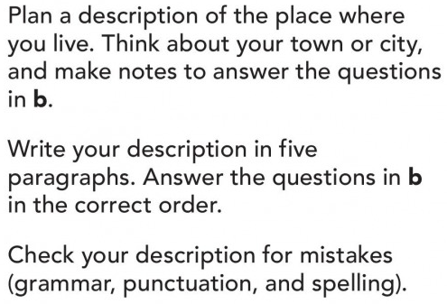

WRITING

Slide 19
